Slide 1
Public sector decision-making
Mark Egan, Special Counsel
14 October 2025

Slide 2
Introduction
VGSO WoVG Legal Induction Program | Public sector decision-making
What is the lawyer’s role in decision-making?
Powers: sources, kinds, roles
How to make valid decisions
Statements of reasons
Review of administrative decisions
Questions welcome as we go

Slide 3
Lawyer’s role in decision making?
Preparing for a decision: design and commencement of process
(best time for legal input, least likely time for legal input to be requested)!
Decision making stage: advising decision maker, brief to decision maker, recording decision
Post decision: notice, publication, reasons
Review of decision: merits (e.g. internal or VCAT) or legal (judicial review in Supreme Court)
Notes:
“I wouldn’t start from here”

Slide 4
Powers and capacities
VGSO WoVG Legal Induction Program | Public sector decision-making
Sources of power:
The prerogative
Executive capacities
Statute
Powers to make decisions / affect rights
Statutory corporations and bare capacities
Powers v capacities (‘liberties’)
Powers that interfere with rights, or with other statutory effects
Capacities held in common with ordinary people (any legal effect general law e.g. contract)
Notes:
Capacities, shared with normal persons e.g.
Contract (for ‘ordinary’ functions)
Appoint advisers
Make policies
Determine who you will contract with
Employee people
Not:
revenue and expenditure
decisions that affect rights, or with statutory effect
Kinds of powers
Discretionary or mandatory/compellable
Divisible: procedural or substantive decisions?
Personal?
Roles
Decision-maker
Assisting and advising
Implementing decisions
Nature of power is relevant to reviewability:
Does the decision mean that the Act affects rights and liabilities? OR
Are rights and liabilities just affected under the general law?
Is it a public power in the performance of a public duty?

Slide 5
Decision-making: A legal framework
VGSO WoVG Legal Induction Program | Public sector decision-making
What is the source of the power?
Who may exercise the power?
Are there procedural preconditions (prior to the exercise of power)?
Are there substantive conditions that need to be satisfied (at time of exercise of power)?
What needs to be done after the fact? (e.g. publication, notice etc)

Slide 6
Decision-making
VGSO WoVG Legal Induction Program | Public sector decision-making
Source of the power?
Right version of legislation?
Legislation valid and applicable?
Commonwealth and State constitutional questions
Who may exercise the power?
Who is the named decision maker?
Is there a validly authorised delegate?
Obtain the instrument
Check compliance with delegated conditions
Implied power to authorise?

Slide 7
Decision-making
VGSO WoVG Legal Induction Program | Public sector decision-making
Procedural preconditions
Need to plan in advance
Express statutory requirements
E.g. recommendation, report, prior notice?
Implied requirements
Natural justice procedural fairness
Rule 1: reasonable opportunity to be heard
Rule 2: no bias

Slide 8
Decision-making
VGSO WoVG Legal Induction Program | Public sector decision-making
Substantive conditions
Proper construction of power (e.g. principle of legality)
Express in the Act
Externally imposed by other Acts
Charter of Human Rights and Responsibilities 2006
Other: Climate Action Act 2017, Flora and Fauna Guarantee Act 1988, Transport Integration Act 2010, Gender Equality Act 2020, Environment Effects Act 1978
Implied:
Proper purposes
In good faith
Reasonableness/rationality

Slide 9
Decision-making
VGSO WoVG Legal Induction Program | Public sector decision-making
Substantive conditions (cont)
Jurisdictional facts: subjective or objective
Considerations: what must be considered (‘relevant considerations’), what may be considered, what must not be considered (‘irrelevant considerations’)
Working ‘backwards’ from other categories of legal error?
Notes:
Grounds widely recognised as jurisdictional (not closed, same actual error can be characterised in many ways…)
Grounds include:
Asking wrong question
Relevant/ irrelevant considerations
Legal unreasonableness/ irrationality: Li
Bad faith/ improper purposes
Absence of jurisdictional fact
Failure to afford procedural fairness

Slide 10
Exercise
See handout
Apply the framework:
What is the source of the power? (Environment Protection Act 2017, s69)
Who may exercise the power?
Are there procedural preconditions (prior to the exercise of power)?
Are there substantive conditions that need to be satisfied (at time of exercise of power)?
What needs to be done after the fact? (e.g. publication, notice etc)
Are there other things we need to look at or know?

Slide 11
Exercise – issue spotting
Power: s 69
Decision maker: EPA, or delegate?
Procedural preconditions
Receipt of (valid?) application
Decision within 4 months
Prior referral to prescribed agencies
Notice of application under s 52 – what is that?
Any residual procedural fairness?
Substantive conditions
Mandatory considerations: s 69(3)
Mandatory considerations: Climate Action Act, s 17
Mandatory considerations: other?? E.g. Charter, Climate Change
(Hidden) subjective jurisdictional facts
Authority ‘considers’ unacceptable risk of harm to human health or enviro: s 69(4)(a)
Authority ‘determines’ the person not fit and proper: s 69(4)(b)
(Hidden) objective jurisdictional fact: s 69(4)(c)
After the fact
Reasonable steps to notify: s 69(6)

Slide 12
Reasons
VGSO WoVG Legal Induction Program | Public sector decision-making
A right to reasons?
Not at common law
Under:
Empowering Act?
the Administrative Law Act 1978? ('decision’, made by a 'tribunal' and requested in time by a 'person affected‘)
If decision is reviewable at VCAT: VCAT Act, s 45
Implications of reasons:
Form part of the record: Admin Law Act, s 10 (‘error on the face of the record’)
Decision maker bound by / stuck with them: East Melbourne

Slide 13
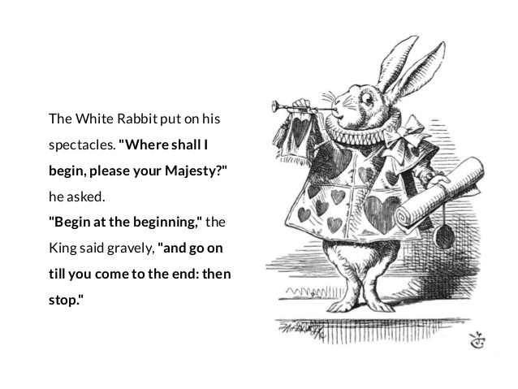
Reasons
VGSO WoVG Legal Induction Program | Public sector decision-making
Standard (Wingfoot High Court)
must explain the actual path of reasoning
in sufficient detail to enable a court to see if there is an error of law
otherwise varies depending on the Act and the decision

Slide 14
Reasons
Form: written, dated, signed
Timing: contemporaneous ideal, after the fact ok
Contents:
Decision: The decision made.
Decision maker: who made it
Law: legislative provisions under which the decision was made
Process: Key steps in the process leading to the decision
Facts and evidence
Logical reasoning: set out the reasoning process leading from the facts and evidence to the decision

Slide 15
Review of decisions
VGSO WoVG Legal Induction Program | Public sector decision-making
Merits review
VCAT
internal
Legal review (judicial review)
Policing the legal limits of powers
Error on the face of the record
Jurisdictional error (LPDT, [1]-[16]):
recognised grounds (but categories ‘not closed’), and
statutory intention for non-compliance to be invalidating (Project Blue Sky), and
material to the decision (Hossain, etc)
Notes:
Grounds widely recognised as jurisdictional (not closed, same actual error can be characterised in many ways…)
Grounds include:
Asking wrong question
Relevant/ irrelevant considerations
Legal unreasonableness/ irrationality: Li
Bad faith/ improper purposes
Absence of jurisdictional fact
Failure to afford procedural fairness
Materiality (LPDT):
The question in these cases is whether the decision that was in fact made could, not would, "realistically" have been different had there been no error.^{[22]} "Realistic" is used to distinguish the assessment of the possibility of a different outcome from one where the possibility is fanciful or improbable.^{[23]} Though the applicant must satisfy the court that the threshold of materiality is met in order to establish that the error is jurisdictional, meeting that threshold is not demanding or onerous.^{[24]}
What must be shown to demonstrate that an established error meets the threshold of materiality will depend upon the error. In some cases, it will be sufficient to show that there has been an error and that the outcome is consistent with the error having affected the decision.^{[25]} Where the error is a denial of procedural fairness arising from a failure to put the applicant on notice of a fact or issue, the court may readily be able to infer that, if fairly put on notice of that fact or issue, the applicant might have addressed it by way of further evidence or submissions, and that the decision-maker would have approached the applicant's further evidence or submissions with an open mind.^{[26]} In those cases, it is "no easy task" for the court to be satisfied that the loss of such an opportunity did not deprive the person of the possibility of a successful outcome.^{[27]} Importantly, a court called upon to determine whether the threshold has been met must be careful not to assume the function of the decision-maker:^{[28]} the point at which the line between judicial review and merits review is crossed may not always be clear, but the line must be maintained. This case affords an example.

Slide 16
Judicial review
VGSO WoVG Legal Induction Program | Public sector decision-making
Procedure
Prerogative/constitutional writs (Supreme Court Rules, Order 56)
Administrative Law Act 1978
Outcome
Certiorari, mandamus, prohibition
Declaration, injunction
Time limits
30 or 60 days from different starts
Can be extended or avoided

Slide 17

Questions?
VGSO WoVG Legal Induction Program | Public sector decision-making
Other resources:
Aronson and Groves Judicial Review of Administrative Action (e-book via VGLS)
Supreme Court, Judicial Review List Practice Note and Template Orders (online)
Civil Procedure Victoria, for commentary on Order 56 and court procedure (Lexis Advance)
Michelle Gordon “Applying reason to reasons” (online)

