Slide 1
Your authorising environment: sources of power
Nidal Sayegh, Lead Counsel
20 May 2025

Slide 2
Agenda
VGSO WoVG Legal Induction Program | Your authorising environment
1
Legislative power
  Exercised by the executive (e.g. a Minister or Secretary) or by statutory bodies
    Delegations and authorisation
Executive power

Slide 3
Legislative power
VGSO WoVG Legal Induction Program | Your authorising environment
2
Creation of power
A statutory power may be vested in:
a person holding office in the executive
(e.g. Minister, Secretary)
an office or body created to exercise particular statutory powers (e.g. Information Commissioner)

Slide 4
Legislative power
VGSO WoVG Legal Induction Program | Your authorising environment
3
Can a statutory power be exercised by someone else?
Presumption that a person invested with a statutory power must exercise it personally.
However, it is common for a decision-maker to be permitted to grant this power to someone else.
Notes:
Image: Buddy Franklin

Slide 5
Delegation
VGSO WoVG Legal Induction Program | Your authorising environment
4
A decision-maker permits another person to exercise a statutory responsibility, power, authority, duty or function that is granted to that decision-maker.
Express
Implied

Slide 6
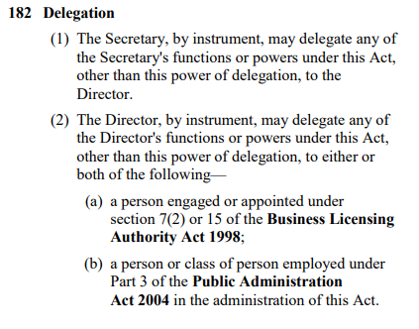
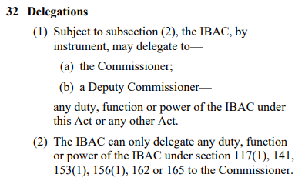
Express power to delegate
VGSO WoVG Legal Induction Program | Your authorising environment
5
An Act will expressly provide that a person with a power may delegate that power:

Slide 7
Restrictions on power
VGSO WoVG Legal Induction Program | Your authorising environment
6
May exist in the legislation (e.g. which powers, and to whom they may be granted).
May be placed on the exercise of power by the delegator (s 42A(1)(b) ILA).
Delegate exercises their own discretion (Northern Land Council v Quall [2020] HCA 33; s 42(1) ILA).

Slide 8
Interpretation of Legislation Act 1984
VGSO WoVG Legal Induction Program | Your authorising environment
7
42A Construction of power to delegate
Power of delegation cannot be delegated (s 42A(1)(aa)).
The delegator retains the power to make the decision (s 42A(1)(a)).
May be subject to conditions or limitations specified by the delegator (s 42A(1)(b)).
The decision is taken to have been made by the delegator (s 42A(1)(c)).
  See also Ginnnane J in JL v Mental Health Tribunal (No 2) [2022] VSC 222 at [9].

Slide 9

Question
VGSO WoVG Legal Induction Program | Your authorising environment
Which of the following requirements would unreasonably constrain a delegate's discretion
A. The delegate must follow the direction of the Chief Operating Officer
B. The delegate must comply with all financial management policies
when exercising their delegated powers
C. The delegate must consult with the Head of People and Culture
D. All of the above

Slide 10
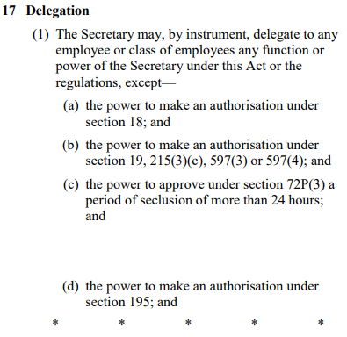
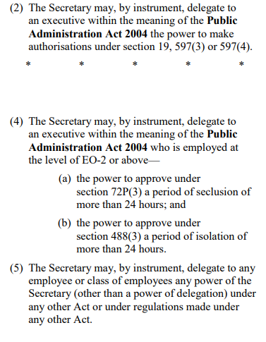
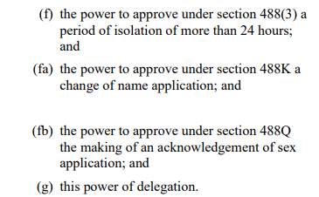
An example – Children, Youth and Families Act 2005
VGSO WoVG Legal Induction Program | Your authorising environment
8

Slide 11
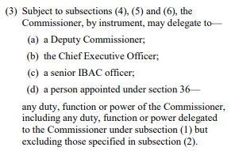
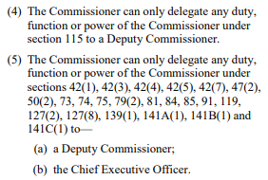
Sub-delegation
VGSO WoVG Legal Induction Program | Your authorising environment
9
Cannot sub-delegate unless expressly allowed (delegatus non potest delegare)

Slide 12
Practical considerations
VGSO WoVG Legal Induction Program | Your authorising environment
10
Choice of delegate.
Delegation to a position.
Acting positions exercise power of delegation.
Revocation/amendment (s 41A ILA).
Briefing a decision-maker.

Slide 13
Practical considerations
VGSO WoVG Legal Induction Program | Your authorising environment
11
Drafting an instrument.
Record-keeping.
When to review delegations and authorisations.
  Organisational change (internal restructure, MOG)
  Legislative amendment
  Change in office holder

Slide 14
Authorisation – Express power
VGSO WoVG Legal Induction Program | Your authorising environment
12
The effect of an authorisation will depend upon the wording of the statute.
Some statutes allow a person to authorise another to exercise some powers of the authoriser.
Other statutes allow a person to authorise another to exercise powers in their own right (e.g. as an ‘authorised officer’ as defined under the Act).

Slide 15
Example – an authorisation to act on behalf of the decision-maker
VGSO WoVG Legal Induction Program | Your authorising environment
13
Section 482B of the Children, Youth & Families Act 2005
The officer in charge of Victorian Youth Justice Custodial Services in the Department may authorise in writing a person or class of persons employed in the Department or engaged by the Department to exercise any power or perform any function of the officer in charge under this Part, other than—
    (a) this power of authorisation; or
    (b) in the case of a person not employed by the Department, a power under section 488AC or 488AD(4) or (5).

Slide 16

Example – an authorisation to act in their own right
14
Section 221A of the Transport (C&M) Act 1983
Authorisation of Departmental authorised officers
The Secretary may authorise a person who is employed or engaged by the Department to act as an authorised officer for the purposes of this Part.

Slide 17
More examples – an authorisation or an appointment?
VGSO WoVG Legal Induction Program | Your authorising environment
15
Section 30 of the Public Health and Wellbeing Act 2008
Secretary may appoint authorized officers
(1) The Secretary by instrument may appoint a person employed under Part 3 of the Public Administration Act 2004 to be an authorised officer for the purposes of this Act.
(2) The Secretary must not appoint a person to be an authorised officer under this section unless the Secretary is satisfied that the person is suitably qualified or trained to be an authorised officer for the purposes of this Act.
(3) An appointment of a person to be an authorised officer may—
  (a) specify the functions, duties or powers under this Act or the regulations to which it relates; and
  (b) be made subject to any conditions that the Secretary considers to be appropriate
Part 9 outlines the powers of authorised officers

Slide 18
Implied power to authorise
VGSO WoVG Legal Induction Program | Your authorising environment
16
Sometimes, a person may authorise another to exercise a power on their behalf even when there is no express statutory power to do so (the Carltona principle).
The authorised person exercises the power as an agent or ‘alter ego’ of the holder of the power.

Slide 19
When can a power to authorise be implied?
VGSO WoVG Legal Induction Program | Your authorising environment
17
Requires statutory interpretation.
Considerations include:
  Administrative necessity
  The consequences of the exercise of the power (i.e. the potential to adversely affect the rights of individuals)
  Whether there is already an express power of delegation.
  Does the power have to be exercised personally?
What about machine technology in administrative decision-making?

Slide 20
Delegations vs Authorisations
VGSO WoVG Legal Induction Program | Your authorising environment
18
 | Delegation | Express Authorisation | Implied Authorisation
Source | Express in legislation* |  | Implied in legislation
Instrument required? | Dependent upon enacting statute, but almost invariably yes |  | No, but recommended
Who exercises power? | Delegate | Dependent upon enacting statute | Principal
Who holds power? | Delegator and delegate (power duplicated) | Dependent upon enacting statute | Principal
If holder of power leaves? | Remains in force | Dependent upon enacting statute | Lapses

Slide 21
Question
VGSO WoVG Legal Induction Program | Your authorising environment
David has been delegated a power. Alexis has been authorised to exercise a power subject to the Carltona principle. The difference between David and Alexis in the exercise of the power is:
A. David acts in his own legal capacity. Alexis acts on behalf of the person
who gave Alexis the power.
B. David signs documents in his own name. Alexis signs documents as the
agent of the holder of the power.
C. David exercises his own discretion. Alexis can only exercise the power in
accordance with the authorisation provided to Alexis; she has no discretion.
D. All of the above.

Slide 22
Question
VGSO WoVG Legal Induction Program | Your authorising environment
Alexis’ manager Moira (who originally authorised her) has left the department to take up a position at Herb Erdlinger Wines. What’s the effect of Alexis’ authorisation now?
A. None, Alexis’ authorisation remains in place.
B. It remains in place if Moira’s replacement is happy for the authorisation
to continue.
C. It remains in place if Alex is happy to continue to exercise the power.
D. It lapses, as the authorisation was personal to Moira.

Slide 23
Executive power
VGSO WoVG Legal Induction Program | Your authorising environment
19
The Crown in right of the State of Victoria has the powers of a private citizen in carrying out its functions
These powers can be limited by legislation, either expressly or by implication

Slide 24

Contracting powers
VGSO WoVG Legal Induction Program | Your authorising environment
20
Contracts involving ‘the ordinary course of administering a recognised part of the government of the State’
Who should enter the contract?
(a ‘proper servant of the Crown’ e.g. Minister, Secretary)

Slide 25
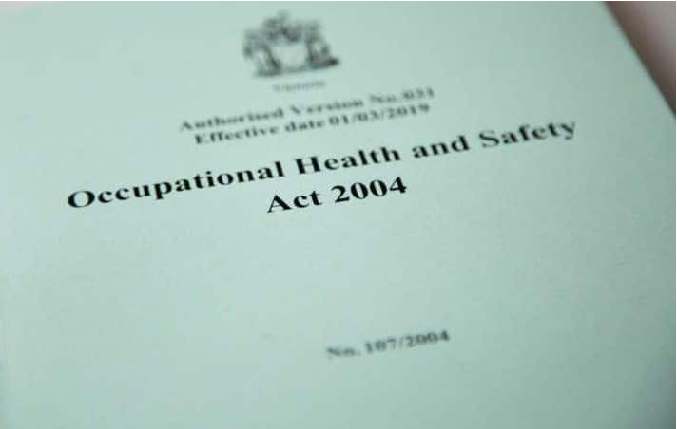


Limitations on executive power
VGSO WoVG Legal Induction Program | Your authorising environment
21
Legislation
Financial authorisation
Rules against fettering future action

Slide 26
Conclusion
VGSO WoVG Legal Induction Program | Your authorising environment
22
What is the source of power to act?
Who may exercise this power?
  Is a delegation or authorisation required?
What limitations apply?

Slide 27
Questions?
VGSO WoVG Legal Induction Program | Your authorising environment
23
Nidal Sayegh
Lead Counsel
nidal.sayegh@vgso.vic.gov.au

