Slide 1
The Government, its branches and you
Sam Hamilton-Lindsay, Senior Solicitor
June 2025

Slide 2
Overview
VGSO WoVG Legal Induction Program | The Government, its branches and you
    Structure of government, in Victoria and federally.
    Key principles that impact on your role - separation of powers & responsible government.
    Some key obligations while working in government.
1
2
3

Slide 3
Introduction - where do you fit in?
VGSO WoVG Legal Induction Program | The Government, its branches and you
Three branches of government in Victoria, reflected in the Constitution Act 1975 (Vic).
You are part of ‘the Executive’ branch of government.

Slide 4
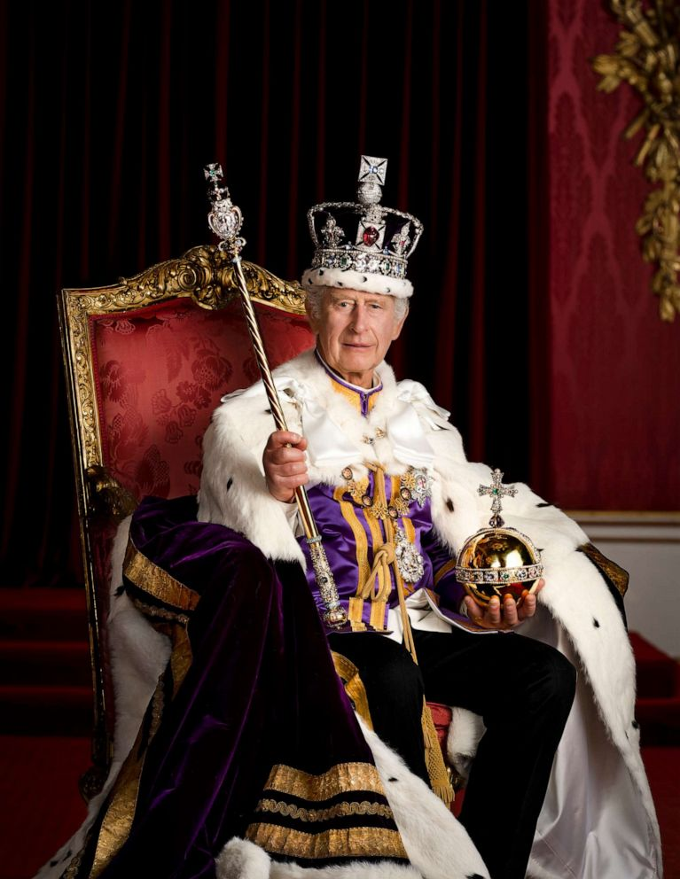
The Executive
VGSO WoVG Legal Induction Program | The Government, its branches and you
The Executive
gets things done
sometimes called ‘the Crown’

Slide 5



The Executive - the Governor
VGSO WoVG Legal Induction Program | The Government, its branches and you
The Governor – appointed by the King
Generally acts on the advice of
the Executive Council
… or the Premier

Slide 6



The Executive - Ministers
VGSO WoVG Legal Induction Program | The Government, its branches and you
The Hon. Sonya Kilkenny MP
Attorney-General
Minister for Planning
The Hon. Danny Pearson MP
Minister for Economic Growth and Jobs
Minister for Finance
The Hon. Ben Carroll MP
Deputy Premier
Minister for Education
Minister for WorkSafe and TAC

Slide 7


The Executive - The Cabinet
VGSO WoVG Legal Induction Program | The Government, its branches and you
The Cabinet
Considers significant matters of State
Governed by conventions:
  Collective responsibility
  Confidentiality
  ‘Need to know’

Slide 8


The Executive - Departments
VGSO WoVG Legal Induction Program | The Government, its branches and you
SECRETARY
The Department Head
Deputy Secretaries and other executives
Employees

Slide 9









Public entities & others
VGSO WoVG Legal Induction Program | The Government, its branches and you

Slide 10
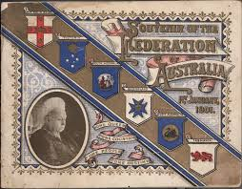
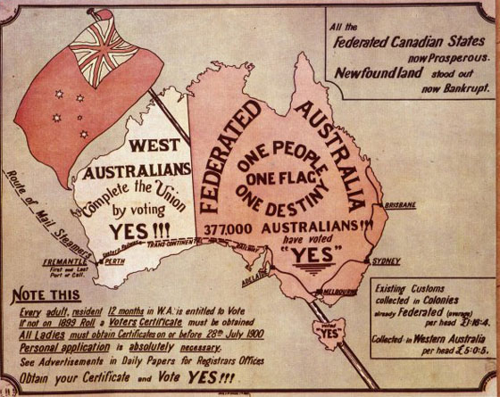
Federal system
VGSO WoVG Legal Induction Program | The Government, its branches and you

Slide 11







Federal system -Division of legislative power
VGSO WoVG Legal Induction Program | The Government, its branches and you
The Commonwealth:
limited legislative power
The States:
broad legislative power

Slide 12
Part 2 - Principles of our system of government
1
Responsible and representative government
Separation of powers
2

Slide 13

Responsible and representative
VGSO WoVG Legal Induction Program | The Government, its branches and you
The Executive
The
Parliament
elect
The people

Slide 14

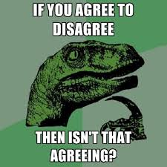


Responsible Government - Ministerial responsibility
VGSO WoVG Legal Induction Program | The Government, its branches and you
Collective responsibility . . .

Slide 15





Responsible Government - Individual responsibility
VGSO WoVG Legal Induction Program | The Government, its branches and you
DTP employee
DTP Ministers
DTP Secretary
Responsible Ministers
The Executive
The
Parliament
The people

Slide 16
Quick question
VGSO WoVG Legal Induction Program | The Government, its branches and you
Linda is employed in the Department of Transport and Planning.
As part of her job she signs a contract for road maintenance works with a friend’s construction company.
Linda did not have authority or approval to sign the contract.
A news article runs a week later. It claims that the State has entered an over-priced contract without a proper tender process. The Builders’ Association demands an explanation.
Who is responsible for the State entering into the contract?

Slide 17
Separation of powers
VGSO WoVG Legal Induction Program | The Government, its branches and you
Functions of government
The Executive
The Judiciary
executive
power
judicial
power
legislative power
The
Parliament

Slide 18
Separation of Powers
VGSO WoVG Legal Induction Program | The Government, its branches and you
Judiciary & Parliament
The Judiciary
The
Parliament

Slide 19
Separation of Powers
VGSO WoVG Legal Induction Program | The Government, its branches and you
Judiciary & Executive
The Executive
The Judiciary

Slide 20
Separation of Powers
VGSO WoVG Legal Induction Program | The Government, its branches and you
Parliament & Executive
The Executive
The
Parliament

Slide 21
Part 3: Our obligations - as public sector employees
responsiveness
integrity impartiality
accountability respect
leadership & human rights

Slide 22
Our obligations - as public sector employees
VGSO WoVG Legal Induction Program | The Government, its branches and you
Impartiality—public officials should demonstrate impartiality by—
making decisions and providing advice on merit and without bias, caprice, favouritism or self-interest
acting fairly by objectively considering all relevant facts and fair criteria
implementing Government policies and programs equitably
Integrity —public officials should demonstrate integrity by—
being honest, open and transparent in their dealings
using powers responsibly
reporting improper conduct; and
avoiding any real or apparent conflicts of interest
striving to earn and sustain public trust of a high level

Slide 23

Our obligations - as public sector employees
VGSO WoVG Legal Induction Program | The Government, its branches and you
Tip #1
Consider impartiality of
public communications
                Campaign criticizing Commonwealth government for providing inadequate funding to Victoria.

Slide 24

Our obligations - as public sector employees
VGSO WoVG Legal Induction Program | The Government, its branches and you
Tip #2
Think before you tweet
VPS Code of Conduct
cl 2.2 Remaining Apolitical
Public sector employees conduct themselves in an apolitical manner. They implement and administer the policies and programs of the elected government. …
cl 3.5 Public Comment
When making a comment in a private capacity, public sector employees ensure … personal comments do not compromise their capacity to perform their public sector role in an unbiased manner…
Michaela Banerji

Slide 25

Our obligations - as public sector employees
VGSO WoVG Legal Induction Program | The Government, its branches and you
Frank & Fearless Advice

Slide 26
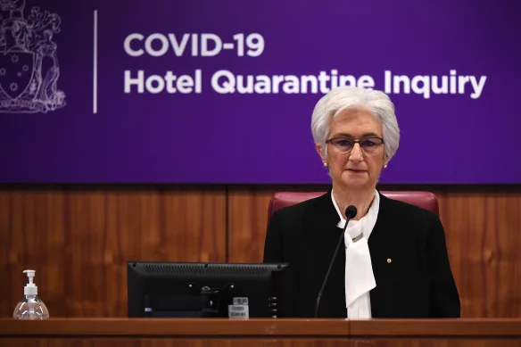
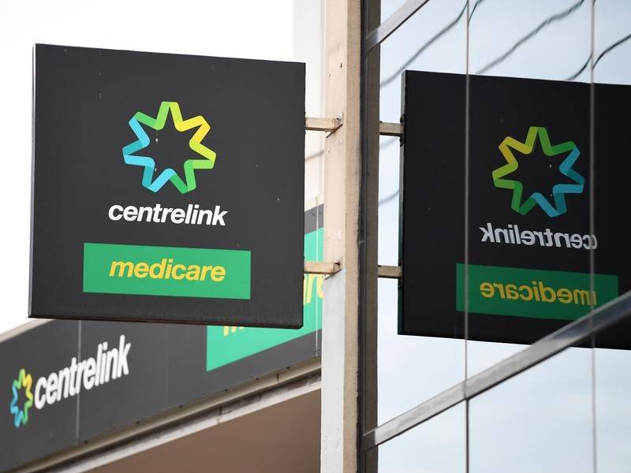

Our obligations - as public sector employees

Slide 27
Frank and fearless advice – scenario
VGSO Winter Clerks Program July 2021 | The Government, its branches and you
You are advising government in the context of a large and ongoing infrastructure project. Part of your advice is to identify and weigh a range of options available to the government to deliver the project. After identifying the available options, you rank them according to how likely they are to deliver the project outcomes whilst complying with relevant laws. Your recommended approach is the approach that delivers the identified project outcomes, at a higher cost, but in a way that presents the lowest risk of non-compliance with relevant laws.
During the life of the project, there is a change of government and the new government considers the project to be too expensive. You are asked to revise your advice so that the approach previously considered in your advice to be the least favourable because it presented the greatest risk of non-compliance with relevant laws is the recommended approach. The approach also happens to be the least expensive.

Slide 28
Frank and fearless advice – options
What do you do?
  Resign
  Provide the advice, revised as requested
  Provide the revised advice, noting in the advice that the changes have been made at the request of your client/stakeholder
  Provide supplementary advice, noting you have been asked to reconsider the recommendation in your previous advice, but noting that you remain of the view that the first recommended approach is preferable
  It depends

Slide 29

Your obligations - a public sector employee
VGSO WoVG Legal Induction Program | The Government, its branches and you
Good to know . . .
Other employment
Gifts & Hospitality
Model Litigant Guidelines

Slide 30

Your role - Your role as a government lawyer
VGSO WoVG Legal Induction Program | The Government, its branches and you
Special responsibility
to uphold the
rule of law
rule of law

Slide 31
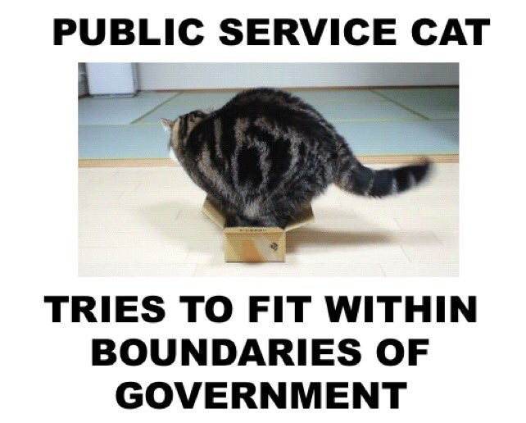
Recap
VGSO WoVG Legal Induction Program | The Government, its branches and you

Slide 32
Questions?
VGSO WoVG Legal Induction Program | The Government, its branches and you
Sam Hamilton-Lindsay
Senior Solicitor
Public Law & Planning
Victorian Government Solicitor’s Office
e. Samuel.hamiltonlindsay@vgso.vic.gov.au

