Slide 1
Regulation, Enforcement and Prosecutions: An overview
Jennifer Butler, Acting Managing Principal Solicitor
23 October 2024
Notes:
Welcome to overview of reg, enforcement and prosecutions.
I’m Jennifer Butler, Acting MPS, IPA Branch.
Welcome to country: Firstly, I’d like to acknowledge the Traditional Custodians of country and their connections to land, sea and community. I pay my respect to their elders past, present and emerging and extend that respect to all Aboriginal and Torres Strait Islander peoples online today
I’ve been at VGSO almost 15 years, spending last 11 years on the CEP team. Predominantly work in prosecutions, disciplinary proceedings – Counsel Assisting in inquiries – and enforcement, including subpoenas.

Slide 2
Presentation overview
VGSO WoVG Legal Induction Program | Occupational Regulation, Enforcement and Prosecutions
2
What is regulation?
Areas of regulation
Approaches to regulation
Industry regulation
Occupational regulation
Compliance and enforcement
Prosecutions
Notes:
Topics we’ll run through today:
What is regulation?
Areas of regulation
Approaches to regulation
Industry regulation
Occupational regulation
Compliance and enforcement
Prosecutions

Slide 3
1. What is Regulation?
VGSO WoVG Legal Induction Program | Occupational Regulation, Enforcement and Prosecutions
3
  A law, rule or directive made and maintained by government or authority.
  Purposes?
  Manage risk and minimize harm
  Control practices, to:
    ensure public safety
    maintain public health
    maintain standards in the provision of goods and services
      c) Control the way people behave, to :
      maintain social order
      protect public interests
Notes:
QUESTION 1: What is regulation?
Described as a law, rule or directive made and maintained by government or an authority. So it comes with an expectation of compliance.
So why is there regulation? The purposes are varied:
The first is to manage risk and minimise harm – the aims and objectives of regulating are broad but generally are targeted to the industry being controlled.
To control practices (or the way something is done), which ensures public safety, maintains public health, and maintains standards in the provision of goods and services.
To control the way people behave, to maintain social order and protect the general public‘s interests – to protect public.
So regulation essentially assists in ensuring public health and safety in different sectors, such as: consumer goods and products; services; transport; the workplace; the environment; and many other areas of public concern.

Slide 4
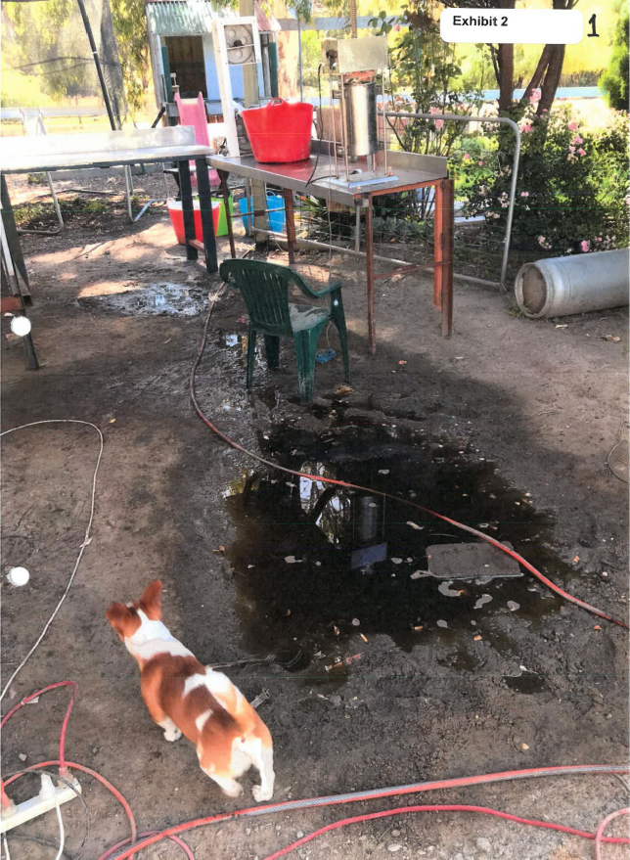
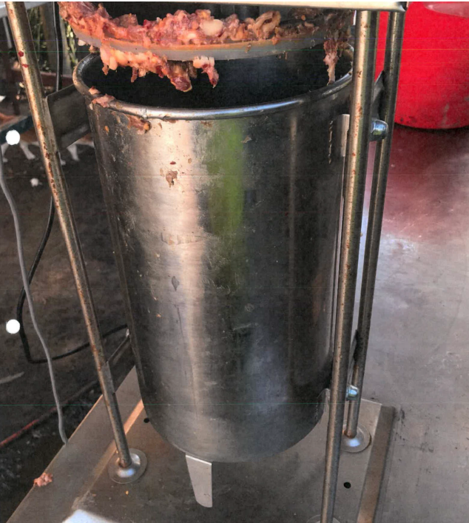
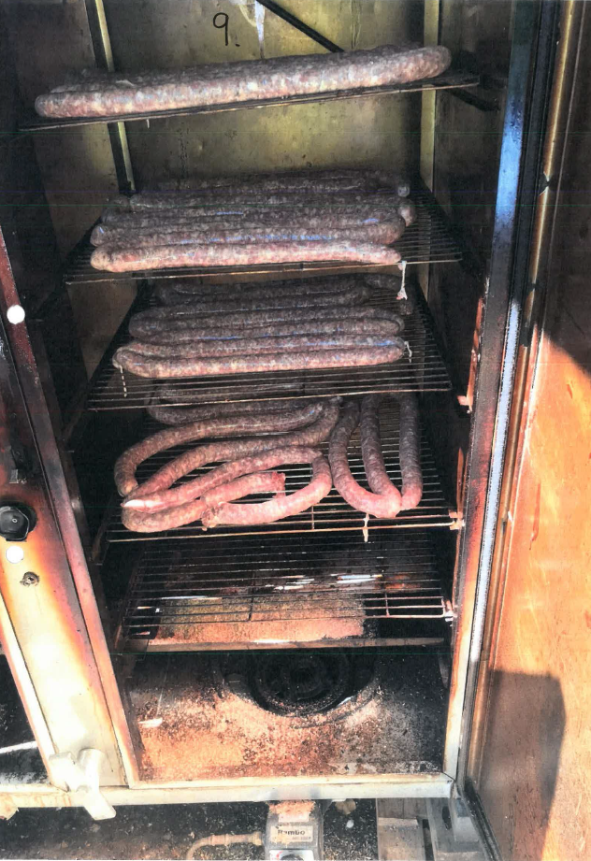
Case study - Regulation
VGSO WoVG Legal Induction Program | Occupational Regulation, Enforcement and Prosecutions
4
Notes:
If we take a look at these photos, can see raw meat, prep area - it looks like a home meat processing facility.
I’m sure you can all identify from the photos activities that might benefit from regulatory intervention?
If we take into account the purposes of regulation from the previous slide – to manage risk, minimize harm, control practices, control behavior, protect public interest – we could ask what might be regulated?
Any guesses?
There’s a dog present, there’s a large spillage, there are cables on the wet ground, it’s outdoors, there’s rust on the meat larder, there’s dirt on grinder.
Regulation – in this case - would be to protect the public from consuming infected or diseased meat or to maintain hygiene standards in the supply of that meat, and also to protect employees if it’s a business.
The Meat Industry Act 1993 establishes PrimeSafe, sets out scheme and standards to apply under Food Act 1984, provides for inspections, testing, audits, licences, quality assurance, a Code of Practice, bans on sale of certain meat for human consumption and slaughter and pet food, systems in place for breaches, setting down of offences, enforcements powers for AOs, evidentiary provisions, who can bring charge (Chairperson or person nominated by Chairperson).
That leads us to discuss our 2nd topic of what are the areas of regulation?

Slide 5
2. Areas of Regulation
VGSO WoVG Legal Induction Program | Occupational Regulation, Enforcement and Prosecutions
5
What industries, occupations or other areas of activity are regulated in the State of Victoria?
Notes:
We’ve asked what industries, occupations or other areas of activity are regulated in Victoria? Any suggestions?
The Victorian Government and its agencies regulate an array of industries, occupations and activities, in order to protect the public interest.
Industry example: Education and Childcare services: regulation: ensures operational requirements meet the National Quality Standard; provides an application process for provider and service approval; establishes a process for rating and assessment of services against the National Quality Standard; sets staffing arrangements and qualifications; sets out fees for a range of transactions.
Examples of occupations over which regulation establishes standards of qualifications, rules of ethics, levels of competence and professional practice rules, are: lawyers (Victorian Legal Services Board + Commissioner), health practitioners (AHPRA, the Australian Health Practitioner Regulation Agency), architects (Architects Registration Board of Victoria), vets (Veterinary Practitioners Registration Board of Victoria) and teachers (Victorian Institute of Teaching). Plus various Tribunals.
Example of another area is the financial sector: so regulation maintains market confidence and protects the integrity of the finance industry by ensuring that all individuals involved in the finance sector and financial institutions meet certain requirements, restrictions, guidelines and they act to a certain standard. Examples include: Australian Securities and Investments Commission; Australian Accounting Standards Board; Australian Financial Security Authority; the Auditing and Assurance Standards Board, Australian Prudential Regulation Authority; Australian Transaction Reports and Investments Commission; Australian Transport Reports and Analysis Centre.
On the next slides, we’ve inserted some examples of regulators for the State of Victoria.

Slide 6











Some Victorian regulators…
VGSO WoVG Legal Induction Program | Occupational Regulation, Enforcement and Prosecutions
6
Notes:
State Regulators include, in alphabetical order (no client favouritism@):
AHPRA mentioned previously (Australian-wide, operating for Victoria and other States)
Energy Safe Victoria which is Victoria's energy safety regulator, responsible for electricity, gas and pipelines safety.
EPA (Environment Protection Authority) which is Victoria's regulator working to prevent harm to the environment from pollution and waste.
Game Management Authority which is an independent authority responsible for the regulation of game hunting in Victoria.
PrimeSafe which is the statutory authority responsible for regulating meat, poultry, seafood and pet food in Victoria. PrimeSafe's primary objective is stated as being “the provision of safe, wholesome meat, poultry and seafood for all consumers”.
Safe Transport Victoria (was CPPV)- regulates the commercial passenger vehicle industry in Victoria – taxis and ride shares. They state that their aim is to “create a commercial passenger vehicle industry that is customer-focussed, safe, accessible and competitive”.
Victorian Fisheries Authority – regulates fishing
Victorian Inspectorate which is the lead integrity body in Victoria – it provides oversight of IBAC and many other integrity, accountability and investigatory bodies.
Victorian Liquor Commission and Victorian Gambling and Casino Control Commission (was part of Victorian Commission for Gambling and Liquor Regulation)
Worksafe Victoria which oversees Victoria's workers compensation system, providing financial as well as health and related support to people who have been hurt in the course of their work. Although WorkSafe is very active in carrying out workplace safety inspections and prosecuting breaches of workplace health, safety and workers compensation laws, a significant focus of WorkSafe's activity includes communication with internal and external stakeholders, media (including publishing details of significant incidents and prosecutions) and the wider community.
We want to focus for a moment on Safe Transport Victoria as an example to discuss what they state as being their purposes, taking us back to our first question of ‘What is Regulation?’.

Slide 7
Safe Transport Victoria
VGSO WoVG Legal Induction Program | Occupational Regulation, Enforcement and Prosecutions
7
  Objective: highest bus safety and marine safety standards
  How can they achieve that objective?
  What other actions do they carry out?
Notes:
The primary role of Safe Transport Victoria on the homepage of their website is “managing the safety, compliance, accreditation and registration for commercial passenger vehicles, buses and the marine sector”.
They adopt the motto of “Safe journeys, every time…” and they state this is “to ensure that everyone who gets into a CPV (Commercial Passenger Vehicle), who boards a bus, who heads out on the water, gets home safely”.
Their purpose is stated as being:
- “Working with industry and community to achieve safe transport outcomes.
- We keep safety front and centre for all people using and operating transport, whether they are on roads or the water.
- By working with partners we can achieve more and enhance our contribution to the community.”
Some of their regulation includes:
- Administering CPPV, bus and marine safety legislation
- Licensing, registering and accrediting operators and other industry participants
- Monitoring the CPV, bus and marine industries’ and participants' systems for managing safety risks
- Monitoring compliance with CPV, bus and marine safety legislation
- Taking enforcement action as appropriate to promote safety outcomes in Victoria.
What other actions do they carry out? They also:
- Investigate and report on CPV, bus and marine safety matters
- Provide advice and recommendations to the relevant Minister on safety issues
- Promote awareness and inform and educate on safety issues, including through practical guidance and training
- Collect, analyse and report on safety data and safety science
- Develop policy relating to the administration of safety legislation
- Represent Victoria in national reform issues, including the Council of Australian Governments' national marine safety regulation agendas
- Maintain constructive relationships with stakeholders in government, industry and the wider community on transport safety.

Slide 8
3. Approaches to Regulation
VGSO WoVG Legal Induction Program | Occupational Regulation, Enforcement and Prosecutions
8
Documented and published
Generally, is risk based
Incudes concepts of being:
  Responsive
  Effective
  Targeted
  Proportional
  Consistent
  Accountable
  Transparent
  Inclusive/Collaborative
Notes:
If we can now thirdly look at differing approaches to regulation.
Many regulators now document and publish their regulatory approach in a Compliance and Enforcement Policy.
Such a policy sets out:
the aims and purposes of regulation relevant to that specific authority; and
often the principles that must be applied by that regulator in administering the legislation applicable to the industry they regulate.
Often the approach is risk based or it can also be targeted at specific harms.
On the slide we’ve listed some concepts that the different regulator might focus on:
-being responsive and effective
So they clearly identify the risk to be addressed and outline their desired aims for their regulatory approach and any action for non-compliance
This brings about required outcomes
- being targeted and proportional
Specific to a group of persons and preventing harm
Takes into account the gravity of the harm involved and the ability and willingness of the person/company to comply
Firm but fair approach, so opportunity is provided to explain the circumstances of any alleged breaches or offending
being consistent and accountable
Ethical regulation
Any decisions made to take enforcement action take into account all relevant evidence
Enforcement action is imposed in consistent way, to where there are similar circumstances
- being transparent, collaborative
The decision making process and potentially any materials relied upon to decide what enforcement action to take is shared and promoted to the public
Any enforcement decisions and the conduct of officers making those decisions is explained and is open to public scrutiny
Might involve an approach from several regulatory bodies to achieve the regulator’s desired outcome

Slide 9
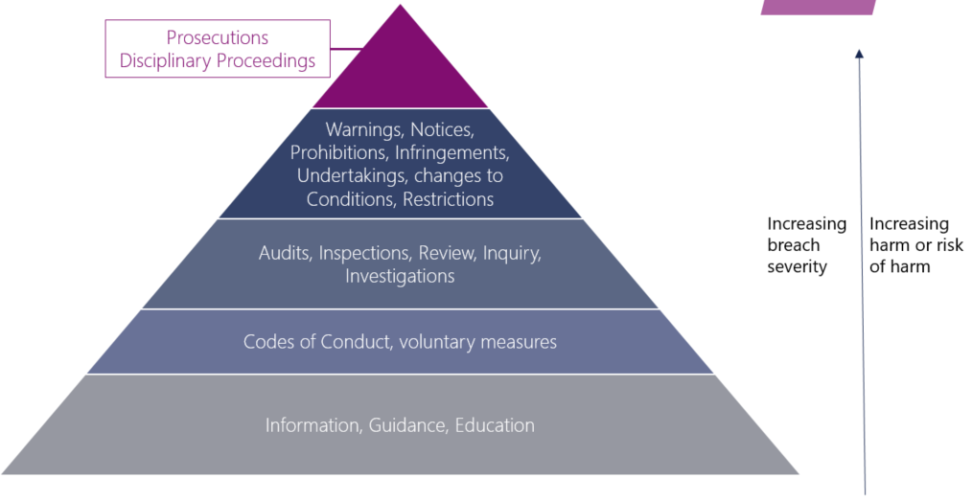
Regulatory approaches
VGSO WoVG Legal Induction Program | Occupational Regulation, Enforcement and Prosecutions
9
Pyramid Structure
Notes:
Generally, regulatory approach is based on what’s called an ‘enforcement pyramid’.
At the widest base there’s an education focus (so providing information and guidance).
Moving up the pyramid, there’s the provision of voluntary measures such as rules and support, Codes of Conduct.
Then upwards to monitoring (audits, inspections, reviews, inquiries, investigations), which all encourage compliance.
Then there’s the use of regulatory tools (such as notices, warnings, cautions, conditions, enforceable undertakings).
Sitting at the top of the pyramid, at its narrowest point, is the initiation of disciplinary proceedings or a criminal prosecution. This is often viewed as a last resort, particularly prosecution. Agencies will often have a prosecution policy usually based on the Prosecution Policy of the Victorian Office of Public Prosecution. That Policy sets out the criteria governing the decision to prosecute and the public interest factors to be taken into account in exercising what is a significant discretion.

Slide 10
Best regulatory approach?
VGSO WoVG Legal Induction Program | Occupational Regulation, Enforcement and Prosecutions
10
What do the majority regulators consider
is the most foundational measure
available to them?
Notes:
If we split the enforcement pyramid into education (at the bottom), then voluntary measures, then monitoring, then regulatory tools (at the top), what are the best measures available to regulators?
Any suggestions?
An important focus of regulators’ framework is voluntary compliance, the base of the enforcement pyramid.
So, education measures such as information and guidance are essential for various reasons:
- To raise awareness and understanding of the legal obligations that apply to those being regulated;
- To inform the sector being regulated of new regulations or those that have changed significantly, if there is little or no awareness of those new or amended obligations;
- Is useful when there’s identifiable breaches but they’re non-safety critical and/or the circumstances surrounding the breach may be minor;
- Also useful when there’s an emerging or known safety issue that’s not well understood by duty-holders.

Slide 11
4. Industry regulation
VGSO WoVG Legal Induction Program | Occupational Regulation, Enforcement and Prosecutions
11
Specific regulatory regimes to operate in some industries
Requirements that may apply
Prescribes range of offences
Notes:
The fourth issue we’d like to examine is Industry regulation.
To operate a business in certain industries there is an applicable specific regulatory regime that must be complied with.
Examples, from list of agencies we identified earlier:
Operating a business that supplies liquor (Liquor Control Reform Act 1998)
Operating a casino (Casino Control Act 1991)
Operating a child care facility (Children’s Services Act 1996)
Operating an aged care facility (Supported Residential Services (Private Proprietors) Act 2010 Vic; Aged Care Act 1997 (Cth))
Operating an abattoir or retail butcher shop (Meat Industry Act 1993)
There are requirements that apply eg might be licensing, accreditation, permits, having nominees (for companies), naming operators, standards of practice, record-keeping requirements
Prescribes range of offences which protects public and, for regulators, sets out the elements of offences or breaches that must be proven.

Slide 12
Additional regulation
VGSO WoVG Legal Induction Program | Occupational Regulation, Enforcement and Prosecutions
12
  Privacy legislation (Privacy Act 1998 Cth) – Federal AOIC
  Workplace safety - WorkSafe
  Environment protection - EPA
  Consumer protection - ACCC
  Anti-money laundering - AUSTRAC
Notes:
In addition to industry-specific regulation, there’s also regulation that applies to businesses generally.
We’ve listed some on the slide, including:
WorkSafe laws apply to:
Building sites – construction works
Race tracks
Agriculture, forestry and fishing
Anti-money laundering laws which apply to :
- Bankers, book makers, card dealers, pubs and clubs, solicitors, not-for-profit sector

Slide 13


5. Occupational regulation
VGSO WoVG Legal Induction Program | Occupational Regulation, Enforcement and Prosecutions
13
Entry requirements:
  Fit and proper person
  Educational qualifications
  Relevant experience or practical training
  Has complied with other registration conditions
Ongoing requirements:
  Fit and proper person
  Continuing Professional Development (CPD)
  Insurance
Notes:
The fifth point we need to consider is Occupational regulation.
There are specific statutes, regulating specific occupations.
Regulatory frameworks may impose occupational entry requirements:
May need to fulfil a ‘fit and proper person’ test
May need specific educational qualifications
May have to have relevant experience or practical training
May have to comply with conditions for registration, such as obtaining insurance
There may also be ongoing requirements:
Continue to be a ‘fit and proper person’
May need to undertake CPD (continued professional development)
Perhaps you need to renew your insurance
We’ve examples on the slides, such as the Victorian Institute of Teaching, the VBA, AHPRA

Slide 14
6. Compliance & enforcement
VGSO WoVG Legal Induction Program | Occupational Regulation, Enforcement and Prosecutions
14
Powers to monitor compliance:
  Appoint officers/inspectors
  Audit
  Investigate complaints/incidents
  Require the provision of information/documents
  Powers of entry
  Apply for search warrant and seize
Notes:
Topic 6.
Part of regulation is ensuring compliance and, if there are failures to comply, enforcement.
Each scheme will have a range of powers to monitor compliance. We’ve listed some of the most prevalent on the slide, including:
Power to appoint AOs/inspectors, to monitor compliance or to enforce
Power to audit
Power to investigate complaints/incidents – may be mandatory notification obligations to the regulator eg notifiable incident
Power to require the provision of information/documents to the regulator (to produce)
Powers of entry to premises for inspection
Powers to apply for search warrant and seize

Slide 15

Enforcement
VGSO WoVG Legal Induction Program | Occupational Regulation, Enforcement and Prosecutions
15
  Warning/caution
  Infringement notice
  Enforceable undertaking
  Disciplinary for regulatory breaches
  Prosecution for criminal offences
Notes:
You’ll remember our enforcement pyramid from earlier. Most regulators have a range of options where there has been non-compliance, some of which we’ve listed on this slide:
Warning/caution
Infringement notice
Enforceable undertaking
Disciplinary proceedings for regulatory breaches
Prosecution for criminal offences
The enforcement response will depend on the severity of the breach.
Legislation may sometimes allow for immediate action by a regulator – is there is significant risk to the public or person.
But generally, legislation provides for an enforcement pathway set out on the enforcement pyramid slide, resulting in either a disciplinary approach or prosecution of criminal offences for regulatory breaches

Slide 16
Administrative tools
VGSO WoVG Legal Induction Program | Occupational Regulation, Enforcement and Prosecutions
16
Legislation may provide enforcement tools
Example of disciplinary proceedings
    Investigation
    Notice of allegations
    Opportunity for person/entity to respond
    Finding
    Determination
Notes:
Legislation may provide for administrative enforcement tools to support enforcement
Some examples are:
Applying for search warrants;
Power to enter premises and inspect; or
Disciplinary proceedings brought against a licensed individual/entity.
Focus on disciplinary process - usually involves:
Investigation phase
Notice of allegations (or notice of inquiry) listing incidents of non-compliance/misconduct/breaches
Service on the respondent of Brief of evidence
Opportunity for person/entity to respond – either in writing or at a hearing
Finding of either ‘not proven’ or non-compliance/misconduct (if satisfied on balance of probabilities)
Determination – fine, reprimand, change to licence conditions (eg further education, training, practice restrictions), suspension, cancellation of licence

Slide 17
Disciplinary action
VGSO WoVG Legal Induction Program | Occupational Regulation, Enforcement and Prosecutions
17
VCAT has jurisdiction to consider disciplinary action and consider refusals
Examples:
  Ahmad v Medical Board of Australia [2017] VCAT 1646
  Victorian Legal Services Commissioner v Logan [2018] VCAT 375 (penalty hearing)
Notes:
Focusing more on disciplinary action, VCAT has jurisdiction to consider disciplinary action either as original decision-maker or on review, and to consider refusals
Ahmad case
- Doctor Ahmad had an Alaskan medical certificate suspended bc of his prescription practices in Alaska (he had made simultaneous prescriptions for the same high-dose opioids).
The Medical Board of Australia relied upon that Alaskan suspension in forming a reasonable belief that Ahmad’s performance as a doctor in Australia would pose a risk to the public. They suspended his licence to practice, in order to protect public health and safety.
That was an immediate-action decision.
- Ahmad applied to VCAT for review of the decision.
- The Medical Board’s decision was affirmed.

Slide 18

7. Prosecution
VGSO WoVG Legal Induction Program | Occupational Regulation, Enforcement and Prosecutions
18
Last resort
Resource intensive
High standard of proof
Serious effects
Model litigant constraints
Notes:
Last topic we want to examine is prosecution.
Ultimately, the decision whether or not to prosecute is a serious matter, which we’ll further discuss in a moment.
But not all offences bought to attention of the regulator must be prosecuted.
Like disciplinary proceedings, prosecution is at the top end of the enforcement pyramid or spectrum of regulatory tools. It’s often viewed as last resort for a number of reasons, including:
Resource intensive: investigation (gathering evidence); conducting record of interview, preparation of brief of evidence; issuing charges; dealing with court proceedings – need to gather sufficient evidence to ensure reasonable prospect of conviction. Takes time.
High standard of proof: beyond reasonable doubt (cf disciplinary proceedings, civil standard balance of probabilities)
Serious effects of prosecution:
Criminal record
Social denunciation
Effect on employment prospects, ie employment checks, questionnaires etc.
Model litigant constraints.
Generally, prosecution of regulatory breaches are:
- More often than not, summary offences (rather than indictable);
- ‘strict liability’ in nature, usually for failing to comply with a legal obligation;
- ‘holding out’ offences, for example:
Architects Act 1991, s 4;
Estate Agents Act 1980, s 38;
Health Practitioner Regulation National Law (Victoria) Act 2009, Schedule s 113;
Veterinary Practice Act 1997, s 57.

Slide 19
Decision to prosecute
VGSO WoVG Legal Induction Program | Occupational Regulation, Enforcement and Prosecutions
19
Policy of the Director or Public Prosecutions Victoria
Decision to prosecute:
  A reasonable prospect of a conviction
  Public interest factors:
    Offence related factors
    Offender related factors
    Victim related factors
    Other factors
Notes:
Examining the decision to prosecute, most regulators either have a Prosecutions Policy (as well as CEP we discussed earlier) or they adopt the OPP’s Prosecutions Policy.
Two criteria to consider in the decision to prosecute:
Reasonable prospect of conviction – also known as sufficiency of evidence, to prove all elements of the offence beyond reasonable doubt – or a prima facie case.
Public interest factors weigh in favour of prosecution.
Public interest factors
The DPP Victoria Policy requires that prosecution must proceed unless there are public interest factors tending against prosecution which outweigh those tending in favour.
There’s a non-exhaustive list of public interest factors to be considered including:
Offence related factors:
the seriousness of the offence;
whether the offence is of considerable public concern;
the age of the offence;
whether the offence is triable only on indictment.
Offender related factors:
the culpability of the offender
the offender’s antecedents and background
the age, physical health, mental health or special infirmity of the offender
whether the offender is willing to co-operate in the investigation or prosecution of others, or the extent to which the offender has done so.
Victim related factors:
the attitude of the victim to a prosecution;
the entitlement of the victim to compensation;
the age, physical health, mental health or special infirmity of the victim.
Other factors:
community protection;
the likely sentence;
the prevalence of the offence and the need for deterrence, both specific and general;
the need to maintain public confidence in basic constitutional institutions such as the Parliament and the courts;
whether the consequences of any resulting conviction would be unduly harsh and oppressive;
any special circumstances that would prevent a fair trial from being conducted;
the age, physical health, mental health or special infirmity any witnesses;
the obsolescence or obscurity of the law;
whether the prosecution would be perceived as counter-productive, for example, by bringing the law into disrepute;
the availability and efficacy of any alternatives to prosecution;
the likely length and expense of a trial;
whether a sentence has already been imposed on the offender which adequately reflects the criminality of the episode;
any mitigating or aggravating circumstances.
The weight to each factor will depend on the circumstances of the case.

Slide 20
Decision to prosecute
VGSO WoVG Legal Induction Program | Occupational Regulation, Enforcement and Prosecutions
20
Improper considerations?
Notes:
Improper considerations
The DPP Victoria Policy states a decision whether or not to prosecute must not be influenced by:
political pressure or interference;
the race, religion, sex, national origin or political associations, activities or beliefs of the offender or any other person involved;
personal feelings concerning the offence, the offender or a victim;
possible political advantage or disadvantage to the Government or any political group or party;
the possible effect of the decision on the personal or professional circumstances of those responsible for the prosecution decision.
Costs of prosecution is not excluded from consideration.

Slide 21
Prosecution - categorisation
VGSO WoVG Legal Induction Program | Occupational Regulation, Enforcement and Prosecutions
21
Section 112 Sentencing Act 1991
1. Summary offences
  Jurisdiction: Magistrates’ Court
  Prosecuting agency (Victoria Police or regulator/VGSO on its behalf) and who may file charge
  Usually strict liability offences
  Max penalties - s 109 Sentencing Act 1991
  Statutory limitation period
Notes:
If decision to prosecute is made, must categorise or classify the offence – although in my view categorisation should take place at the investigation stage as the answer will inform the applicable laws for investigation, such as application of s 464 of Crimes Act 1958 for records of interview etc.
Two types of offence: summary and indictable. Section 112 of Sentencing Act 1991 categorises offences.
Effectively, offence that carries max penalty of Level 1 to 6 imprisonment (5 years or more) or Level 1 to 6 fine (600 PU or more) or both or above is indictable, unless contrary intention appears.
Summary offences
Informs jurisdiction – Magistrates’ Court from charge to sentence, with no period within which first mention must be listed in summary stream.
Determines prosecuting agency – VicPol or regulator (or VGSO on regulator’s behalf) – and who may file charge – specified in offence provision or Act.
Regulators’ offences are generally summary offences.
Usually strict liability offences – only defence is ‘honest and reasonable mistake of fact’ (not mistake of law)
Penalty scale in s 109 of Sentencing Act 1991. Sliding scale from Level 1 to 9 imprisonment and Level 1 to 12 fines.
Effectively, summary offences are max 2 years imprisonment (Level 7) and 240 PU fine (Level 7) or both.
Categorisation of offence as summary offence also informs statutory limitation periods – generally within 12 months after offence commission date.

Slide 22
Prosecution - categorisation
VGSO WoVG Legal Induction Program | Occupational Regulation, Enforcement and Prosecutions
22
Examples of summary offences:
‘Holding out’ offences
Breach of licence conditions
Operating a business without a licence
Misuse of position as a councillor
Failing to vote State and Local Council elections
Notes:
‘Holding out’ offences I mentioned earlier such as:
Architects Act 1991, s 4, s 5, s 6
Estate Agents Act 1980, s 38
Veterinary Practice Act 1997, s 57
Private Security Act 2004, s 6
Health Practitioner Regulation National Law (Victoria) Act 2009, Schedule s 113, or using title, s 116, s 118
Breach of licence conditions
Operating a business without a licence
Misuse of position as a councillor
Failing to vote State and Local Council elections

Slide 23
Prosecution - categorisation
VGSO WoVG Legal Induction Program | Occupational Regulation, Enforcement and Prosecutions
23
  2. Indictable Offences
  Jurisdiction: committal in Magistrates’ Court, then trial in a Superior Court
  Classification of offences: s 112 Sentencing Act 1991 (other than the Crimes Act 1958 and Wrongs Act 1959):
  Level 1 (Life imprisonment/3000 penalty units) to Level 6 (5 years imprisonment/600 penalty units)
  Unless the contrary intention appears
Application to determine some indictable charges summarily
No limitation period
Notes:
2. Indictable Offences – second category of offences is indictable.
Again, categorisation affects jurisdiction: for indictable offences, filing hearing (not mention) in indictable stream within 28 days of issue of charges, with committal mentions then committal hearing in Magistrates’ Court. If committed, the trial will heard in a Superior Court – County or Supreme Court. After committal hearing, the Office Of Public Prosecutions is responsible for the prosecution.
Again, section 112 of Sentencing Act 1991 applies, so indictable offence is described in a provision of an Act (other than the Crimes Act 1958 and Wrongs Act 1959) as being Level 1 (Life imprisonment/3000 penalty units) to Level 6 (5 years imprisonment/600 penalty units), unless the contrary intention appears.
An application can be made for some indictable charges (level 5-6)/maximum 10 years imprisonment/1200 PU) to be determined summarily (s 28 and s 29 CPA)
No limitation period

Slide 24
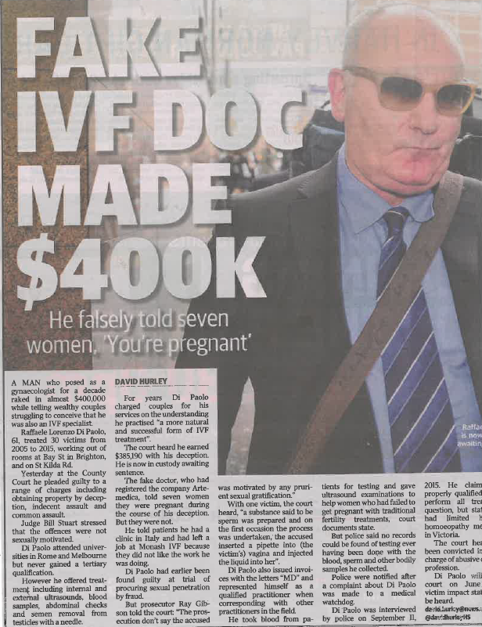
Case: Di Paolo
VGSO WoVG Legal Induction Program | Occupational Regulation, Enforcement and Prosecutions
24
Notes:
Example of case for regulator re holding out offence
- Di Paolo was a homeopath – he and his company held him out to be an IVF specialist, gynaecologist and obstetrician for over a decade
- used title to convince many vulnerable women and their partners to engage his services
- he conducted examinations of the women (pelvic ultrasounds) and sometimes even their partners too
- injected unknown substances into the women
- took blood samples
- in some instances, he told the women they were pregnant
He and his company were charged by AHPRA (Australian Health Practitioners Regulation Agency) with 'holding out' offences and using the titles of 'MD', 'gynaecologist' and 'obstetrician'
- As a result of these charges and the media attention it attracted, further women came forward and Victoria Police conducted further investigations into the matter (AHPRA was restricted to charging within 12 months of the offences having occurred)
- He was further charged with sexual offences, assault, and obtaining financial advantage by deception
- Ultimately sentenced in the County Court of Victoria to imprisonment of 9 years and 6 months, to serve a minimum term of 6 years, 6 months on the Victoria Police charges
- Re AHPRA holding out charges, he was fined $5,000 and ordered to pay AHPRA's legal costs + the company was fined $8,000 and ordered to pay costs

Slide 25
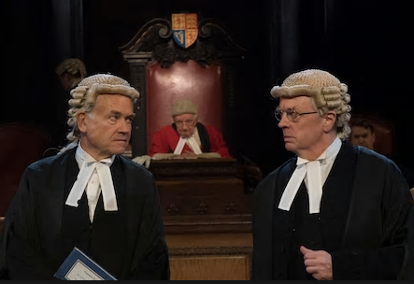
The role of the prosecutor
VGSO WoVG Legal Induction Program | Occupational Regulation, Enforcement and Prosecutions
25
Notes:
The final part of prosecution that we need to consider is the prosecutor’s role or duties.
The criminal process is accusatorial and adversarial in nature.

Slide 26
Prosecutor’s duties
VGSO WoVG Legal Induction Program | Occupational Regulation, Enforcement and Prosecutions
26
Duty to assist Court arrive at the truth
Duty to the community
Duty to act impartially, independently and fairly
Duty to test, and if necessary attack, inaccurate assertions advanced on behalf of an accused
Sentencing obligations
Notes:
Prosecutor's duties
First duty is to the Court; the prosecutor needs to seek by all proper means to assist the court to arrive at the truth.
Secondly, duty of fairness to the public or community, as a ‘Minister for justice’. The community’s interest is twofold:
That those who are guilty be brought to justice;
Those who are innocent not be wrongly convicted.
Also duty to act impartially, independently and fairly – ensure that:
Those who are guilty be brought to justice
Those who are innocent not be wrongly convicted
Duty to test, and if necessary attack, that advanced on behalf of an accused or evidence adduced by that accused - still entitled to firmly and vigorously urge the prosecution’s view about a particular issue).
Sentencing obligations – put comparable sentences before the Court. Not a duty to push for a conviction, but to help ensure an accused’s trial is a fair one Barbaro

Slide 27
Questions?
VGSO WoVG Legal Induction Program | Occupational Regulation, Enforcement and Prosecutions
27
Inquiries, Prosecutions & Administrative Law Branch
Victorian Government Solicitor’s Office
Jennifer Butler
Acting Managing Principal Solicitor
e: jennifer.butler@vgso.vic.gov.au
Will Yates
Assistant Victorian Government Solicitor
e: will.yates@vgso.vic.gov.au

