Slide 1
Information Sharing in Government:
Privacy and Freedom of Information
1 May 2023
Andrew Field, Managing Principal Solicitor
James Stephens, Principal Solicitor
4 June 2025
Notes:
"I acknowledge the Traditional Owners of the land on which I am joining you from today. I pay my respects to their Elders - past, present and emerging - and the Aboriginal Elders of other communities who may be joining us today"

Slide 2

Regulators
VGSO WoVG Legal Induction Program | Information sharing in government
Office of the Victorian Information Commissioner
Deputy Commissioner Privacy and Data Protection
Deputy Commissioner Public Access
Notes:
Lets look briefly at the regulatory structure for these components of Information Management, which explains why we hold privacy and freedom of information together. The Office of the Victorian Information Commissioner is a statutory authority, established under the PDP Act, and it regulates the functions of:
Privacy and Data Protection; and
Freedom of Information.
Sean Morrison was appointed in February 2024 as Victoria’s new Information Commissioner. He is supported by Deputy Commissioner for Privacy and Data Protection, being Rachel Dixon [as at June 2025], and Deputy Commissioner for Public Access (the other term for Freedom of information), being Penny Eastman [as at June 2025].
I am going to talk about the Privacy and Data Protection area, and Andrew is going to cover Freedom of Information.

Slide 3
Agenda
VGSO WoVG Legal Induction Program | Information sharing in government
An introduction to the statutory information privacy and data protection requirements as they apply to the Victorian Government and Victorian Government Agencies.
A practical checklist for information sharing
Notes:
Quick agenda , it is an introductory session today. I will introduce the concepts of information privacy and data protection, and outline the main components of the law in this area and tell you were to find it.
Then we’ll try and give it a practical lens and touch on the way you should approach how you use or share information with others. This is likely to be the most common information handling scenario you will encounter.
I’ll then hand over to Andrew, whose going to take through the second component of this session: Freedom of Information

Slide 4

Part 1: The Privacy Landscape
Privacy is about protecting personal information.
Personal information means information or an opinion that is recorded in any form, whether true or not about an individual whose identity is apparent or can reasonably be ascertained from the information or opinion.
This can extend to combinations of de-identified information which together, can allow the identity of an individual to be ascertained.
Your Name
Your DOB
Your address
Your account
Your Biometric information
An image of You
Notes:
So, the privacy landscape. Some introductory comments to help us think about this concept of privacy the right way - Privacy is a right, and like all rights, this involves a balance between the rights of individuals and the state’s legitimate interests in using the information to carry out functions and govern in the wider public interest.
We are given some legal tools to undertake that balancing exercise, (and we’ll touch on these shortly), but the answer to a privacy issue may not always be so black and white or strictly legal in nature. And sometimes, as advisors to your organisations, you may need to view privacy issues from the lens of a potential complainant, not a lawyer. Complainants probably don’t read the legislation and for them, whether or not an infringement of their privacy is lawful, is only part of the issue or the reason they have complained.
So what are we talking about when we refer to information privacy? Privacy is about the obligation on the state to protect personal information.
Personal information is any information or opinion about an individual which can reasonably identify them. It may be my name, my date of birth, my photograph, video footage of me, bank account or details or biometric information, like finger prints or facial patterns. It may be a combination of these things, or other things, which when taken together have the ability to reasonably identify me.
Note also that personal information can be a fluid concept, too. Information may start out as a seemingly anonymous dataset, with no obvious identifiers (so no names, dates of birth etc), but when these units of anonymous data are matched with other datasets, individuals may become identified or at least reasonably identifiable. So you need to be careful about how you are de-identifying data and when you release anonymous datasets publicly as there may be other datasets out there which enable re-identification much easier than you might have expected.
Protecting the personal information of individuals will come up for your agency in a variety of contexts:
In determining the personal information that an agency should collect, and how it goes about this
Considering when and how an agency can use the information it holds and whether it can share the information with other parts of government and/or outside of government
Maintaining the appropriate control over the protection and security of the information you holds both within the agency, and pursuant to any contract under which a service provider has access to the information

Slide 5
Legal Framework
VGSO WoVG Legal Induction Program | Information sharing in government
Default privacy legislation establishing the framework and principles:
  Privacy and Data Protection Act 2014
  personal information excluding health information (IPPs schedule 1)
  Health Records Act 2001
  (HPP’s Schedule 1) – information or opinion about a person's health
  Other legislation may prevail over PDP Act and HR Act, to the extent of any inconsistency
Charter of Human Rights and Responsibilities Act 2006
    Protects the right of an individual not to have their privacy interfered with unless lawful and not arbitrary
  Privacy Act 1988 (Commonwealth) [amendment bill introduced September 2024]
  Binds Commonwealth agencies and private entities with turnover of more than $3m. APPs similar to the IPPs.
Victorian Data Sharing Act 2017
  Provides an authorising environment for sharing anonymised data to support data analytics
Notes:
So what are our legal tools to govern the protection of people’s privacy?
Two principle pieces of legislation in Victoria, which you should be familiar with, are the Privacy and Data Protection Act and the Health Records Act.
The PDP Act is concerned with how the public sector collects, uses, discloses and handles individual’s information (which isn’t health information). It establishes the Information Privacy Principles in schedule 1 and requires that all public sector agencies, which is all of you, comply with the Information Privacy Principles. The Information Privacy principles are a set of principles, which regulate the collection; use; disclosure; disposal and access to personal information. Will discuss further in a moment.
The Act also:
establishes the role of Office Victorian Information Commissioner and
contains some flexibility mechanisms to allow OVIC to step in and determine that an infringement of privacy is not in contravention of the Information Privacy Principles or is otherwise allowed under a public interest exemption, although it should be said that these flexibility mechanisms are not used often.
The Health Records Act does similar things but in relation to health information. Health Information is any information or opinion about the health or treatment of a person who can be identified.
A different feature of the HRA is that it applies to both public and private sector organisations who provide health services in Victoria or hold health information. This includes private health clinics, hospitals, schools and any Victorian government department or agency which handles health information.
Now, here’s the important thing about both the PDP Act and the Health Records Act. Unfortunately the answer to your privacy issues doesn’t start and end in these two pieces of legislation because both those acts contain provisions which state that where another act is inconsistent with those acts, the other acts prevail.
And there is a lot of legislation out there which deals with the handling of information so you will need to become familiar with the legislation relevant to your functions and use that as your stating point to determine your authorising environment obligations. If those other acts are silent, then you fall back on the PDP act and HRA as your starting point and work within the IPPs and HPPs in those acts.
It’s also always necessary to consider the Charter. All Victorian agencies must comply with the Charter of Human Rights and Responsibilities Act.
The Charter gives a person a right not to have their privacy unlawfully or arbitrarily interfered with.
This Charter right to privacy is therefore broader than the rights afforded by other legislation. It goes beyond just information privacy, and requires that an infringement of a person’s privacy must not only be lawful but not arbitrary. In practice, this means agencies will need to ensure that they only interfere with an individuals privacy where there is a clearly articulated purpose for doing so and only to the extent necessary to meet that purpose.
The Privacy Act (Cth). This Act protects the privacy of individuals in a similar way to the Victorian legislation, but generally only binds Commonwealth government agencies and private sector organisation with a turn-over of more than $3m. There are some instances where the Cth Act will be directly relevant to Victorian government agencies:
- Corps Act companies that are also state owned or controlled might be in the situation where both the Victorian and Commonwealth law applies, so may need to consider both regimes
- the handling of tax file numbers, so the Cth act will be relevant to your organisation in the context of managing employee records.
Good to have an understanding of Cth legislation exists because this is generally the standard to which your Suppliers are held, and you’ll want to ensure that they adhere to the law when they provide services to the State, and also because the Cth Act often paves the way for privacy reform more generally.
[Be aware that the Cth introduced a bill to amend the Privacy Act earlier this month. The bill introduces:
Children's Online Privacy Code (applying to social media platforms, and other electronic services which are likely to be accessed by children.
New requirements for transparency around Automatic decision making ( the Bill introduces new requirements for transparency around automated decision making, when the computer program substantially or directly makes a decision using personal information. APP entities have 24 month grace period from the time of Royal Assent before the new requirements come into effect.
Increases the penalty amounts and introduces a multi-tiered civil penalties system - (i) a mid tier penalty for general privacy interference (max penalty $3,130,000), and (ii) infringement notices available for a variety of prescribed contraventions (max penalty $313,000).
OAIC monitoring and investigation powers have been significantly expanded
Introduces a statutory tort for serious invasions of privacy for individuals to seek redress for privacy harms in court.
Clarifying when personal information may be sent for overseas processing (the exceptions of APP 8.
Amongst other things so watch this space.]
And finally, the Victorian Data Sharing Act. This Act is designed to facilitate sharing of information to support data analytics work to deliver or design policy and services. This act provides an authorising environment for agencies to share de-identified data for that purpose, even where there might be a secrecy provision in legislation. The act establishes the role of the Chief Data Officer and provides a mechanism to request further information for data analytics purposes. If your agency receives a request from the Chief Data Officer under this act, you’ll need to respond to it (although you are not compelled to provide the data if you have a good reason not to).

Slide 6
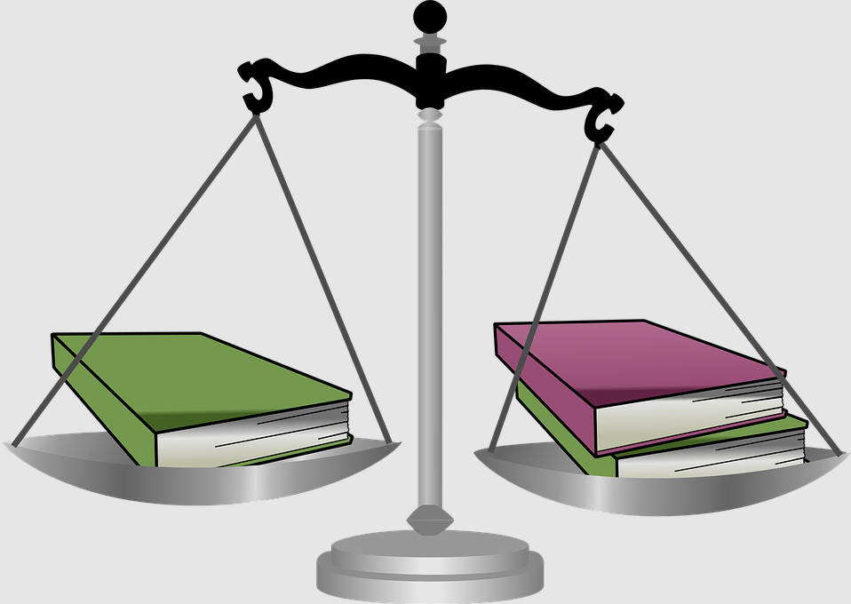
Other legislation can override
VGSO WoVG Legal Induction Program | Information sharing in government
Other legislation can contain more specific provisions in relation to privacy which will override the information privacy principles
Child Wellbeing and Safety Act 2005 (as amended by the Children Legislation Amendment (Information Sharing) Act 2018);
Children, Youth and Families Act 2005;
Corrections Act 1986;
Family Violence Protection Act 2008 (as amended by the Family Violence Protection Amendment (Information Sharing) Act 2017);
Mental Health and Wellbeing Act 2022;
Public Health and Wellbeing Act 2008;
Serious Sex Offenders
(Detention and Supervision) Act 2009;
Victoria Police Act 2013.
Notes:
I mentioned earlier that the PDP and HRA are default legislation, and other information sharing regimes that are more specific will prevail over those two acts. This is a sample of legislation that contains express provisions around how information is handled.
This is by no means an exhaustive list.

Slide 7
The information privacy principles
VGSO WoVG Legal Induction Program | Information sharing in government
Proportionality
Purpose limitation
Organisations should only collect personal information as necessary to carry out their functions, and should minimize the intrusion into privacy.
Generally, personal information should be used only for the purpose for which it was collected (the primary purpose).
Openness and transparency
Individual participation
Individuals should be made aware of the information held about them and why and should be able to see it and correct it if necessary.
Individuals should have as much say as possible in what their personal information is used for and who gets access to it.
Notes:
So lets’ look at these IPP’s referred to earlier. Complying with these principles is the crux of acting compliantly in this area. These are your default principles, in the absence of more specific legislation, which govern how the state collects, uses/shares, stores and handles individual’s personal information. If you get a good grounding in these principles, it will all start to make sense.
Warning!
I am going to take a total of 10 principles spread over six pages of legislation and distil them into 4 categories. Please do read the IPPs (and HPPs) in full but we don’t have time go through all the principles for the purposes of today.
Proportionality – Only collect the information which is necessary for you to perform your functions. And minimise the intrusion into a person’s privacy when you do so.
In practice, this means get the information directly form the person if you can and ensure there is a clear connection between what you ask for and what you actually need. No fishing exercises – (collecting information just in case) which may result in surplus information being held for no real purpose. Particularly important in our current climate of cyber security threats for digital storage solutions.
Purpose Limitation
Once you have the information, only use it for the same purpose for which it was collected to carry out your functions,, unless you fit within an exception to this principle.
Exceptions include using personal information :
to investigate and prevent a crime,
to prevent serious injury or harm to a person,
To comply with some other law which requires you to do something;
for a reasonably expected secondary purpose, or
Where the individual to whom the information relates, consents to their information being used for a difference purpose than that for which it was collected.
Be careful about consent. It can be an attractive model for agencies but what if you really want to do the project and consent isn’t forthcoming? And of course sometimes it’s just not practical to get a person’s consent.
There are also principles around consent and what that means and you’ll need to consider how you achieve valid consent on a case by case basis. (It’s got to be informed, current, specific and properly voluntary)
Another aspect of the Purpose Limitation category of principles is that personal information can’t be taken outside of Victoria unless you’re reasonably sure that there are protections which will travel with that information. Increasingly tricky with Cloud digital solutions where data is often processed outside Victoria – one to ask when you procure services.
Openness and transparency – People need to know why you’re collecting information from them and what you’re going to do with it, at the time you collect it.
You need to allow people access the information you hold about them and to correct their personal information.
In practice, this means you need to have a clearly established and displayed privacy policy setting out in plain English terms how you’ll use personal information.
A layered policy, (click on the bit you need to know) is probably the better approach, more user friendly. A clear, plain English policy might also help avoid complaints from the public about how their information has been used.
You may be required to provide information to people about why you are collecting their information at the time of collection. These are called collection statements, and they are different to privacy policies.
You also need to establish systems to ensure that this public access and correction can occur with a minimum of hassle. If the public struggle to get access to the information you hold about them, this may start to break down trust, complaints arise, possible reputational damage etc so its important to get this right.
Individual participation - Keep the individual involved - remember information privacy is about rights - People should have as much say as possible in what information about them is used for and who gets access to it. Where practicable, allow people to remain anonymous.
Even if you can’t involve individuals in the reasons and/or approach to collecting and use of their information, for good reasons to do with your functions, you can still keep a constructive dialogue going with them, which may also avoid perceptions or concerns from people about mishandling of their information, and therefore avoid complaints.
A word of caution, the HPP’s are similar to the IPP, but not the same and do vary in some areas, particularly as they apply to private sector health organisations as well as state agencies, but broadly the principles follow similar themes.
OVIC publishes very useful guidance on the IPPs which it has updated in last few years. You can find it on its website.

Slide 8
Sensitive personal information
VGSO WoVG Legal Induction Program | Information sharing in government
Special rules apply to sensitive personal information for example:
racial or ethnic origin
political stance
Religious beliefs or affiliations
sexual preferences or practices
criminal record
An Organisation must not collect sensitive information about an individual unless:
the individual has consented,
the collection is authorised by law, or
is necessary to protect life or provide defence to a legal claim
Notes:
Special rules apply to sensitive personal information There are some examples of categories of sensitive information in the slide there. Schedule 1 of the PDP act defines the full list of categories of sensitive information and IPP 10 requires you to handle sensitive information in a special way.
Information or an opinion about an individual's
racial or ethnic origin
political opinions
membership of a political association
religious beliefs or affiliations
philosophical beliefs
membership of a professional or trade association
membership of a trade union
sexual preferences or practices
criminal record
An Organisation must not collect sensitive information about an individual unless:-
The individual has consented
the collection is required or authorised under law
the collection is necessary to prevent or lessen a serious threat to life or health
Or necessary for exercising or establishing a defence to a legal or equitable claim

Slide 9
Privacy Impact assessments
VGSO WoVG Legal Induction Program | Information sharing in government
A privacy impact assessment is a process designed to assess and manage the impact of a program on the privacy of individuals.
An assessment should be encouraged to be undertaken whenever a new personal information collection, handling or sharing arrangement is proposed
Notes:
You may be familiar with privacy impact assessments (or PIAs). These are processes to assess and manage the impact of a project or activity on individuals’ privacy. The point of a PIA is to draw out the privacy risks and identify risk mitigation activities which can then be factored into your project and any information handling agreements.
There is no express legislative requirement to conduct one, but it’s best practice to undertake a privacy impact assessment whenever personal information will be shared in a routine and/or significant way.
There is no specific or prescribed form for a PIA but OVIC does have a template on its website. Or your organisation’s privacy team (if you have one) may have their preferred format. Whatever form you use, it is best to document the process the agency has been through to assess the privacy impact.

Slide 10
Checklist for approaching information use/sharing
VGSO WoVG Legal Induction Program | Information sharing in government
Checklist for approaching information use/sharing
1) What type of information is it?
2) Do you have authority to use / share it? Purpose of collection?
If personal
(or health)
3) Is there any specific legislation which overrides the IPPs/HPPs
4) Is the use/sharing otherwise consistent with the IPPs/HPPs?
Remember
Consider the Charter – not arbitrary as well as lawful?
Document your decision making with Privacy Impact Assessments and Information Sharing Agreements
5) Then use/share consistently with the IPPs (and HPPs)
Notes:
Practically then, how to you approach information sharing/use? This is likely to be one of the most common information handling scenarios you come across. Lets test what we’ve been discussing in this session so far.
First [starting top left there] what type of information is it? Must be personal information capable of identifying a person. Statistics about how many people have applied for a fishing licence, say, is not personal information. De-identified information may not be personal information either, but if datasets can be combined with other available datasets, people may be identifiable.
What is your authorising environment? Do you have express legislative provision which authorises you to share or handle information in a particular way? Why id you collect this information?
Be sure there are no specific provisions in any legislation which prevent the sharing or override the IPPS/HPPs. For example, the Corrections Act has secrecy provisions, a prohibition on sharing certain information about persons.
If there are none of those prohibitions, does your sharing, otherwise fall within the IPPs. So are you using the information for the purpose you collected it or do you fall into an exemption?
Assuming you are using the information for the reason you collected it, and you have authority to share, make sure you share in accordance with the IPPs (or HPPs). For example, share securely, do not across state borders until you have the right protections in place to travel with the information, make sure the information is accurate and up to date.
Some overlays:
Don’t forget the Charter – should be lawful and not arbitrary – you should have an articulated purpose for the sharing.
Document your decision making – as mentioned, best practice to a Privacy Impact Assessment before you share and keep doing them as projects evolve.
Routine or larger scale sharing should have written information sharing terms. Agencies often enter into Information Sharing Agreements and this is particularly important when sharing with non-government agencies. They can be useful privacy and data protection tools to assist with compliance, but they wont fulfil compliance per se.
.

Slide 11

What if we get it wrong?
VGSO WoVG Legal Induction Program | Information sharing in government
Some legislative confidentiality/secrecy provision create offences
Failure to follow PDP Act may result in complaint to OVIC or investigation. OVIC may:
  decline to entertain a complaint;
  refer complaints to VCAT; or
  issue compliance notices for serious breaches
Most serious consequence to government is reputational damage and loss of public confidence
Notes:
What happens if we get privacy wrong?
Some legislation creates an offence and imposes a penalty for breaching confidentiality or secrecy provisions in relation to information, regardless of whether this is personal information or not. So that’s the first thing.
Failure to follow the PDP Act (or the IPPs under the Act) may result in a complaint to OVIC. OVIC may decline to investigate a complaint particularly if it feels that the agency is doings its best to resolve it, or if it cant be resolved OVIC may refer the matter to VCAT.
Where there are serious or repeated breaches of the IPPs, OVIC may issue a compliance notice. It doesn’t do this often, generally, OVIC’s approach to complaints made to it is based on supporting resolution at an early stage.
The most serious consequence for government is reputational damage and loss of public confidence. Government never really entirely avoids this risk, even if its not legally liable for privacy breaches because it’s successfully passed on the liability to the third party supplier, for example, it never really loses the moral obligation and accountability to the public.
[Latest Statistics if you’re interested: From the 2020-2021 OVIC annual report, OVIC finalised 69% of complaints without the need to refer the complaint to VCAT.
[The number of privacy complaints decreased compared to 2019-20. This is a reversal of a multi-year trend of rising complaint numbers. This change may signal a change in how agencies are handling personal information or what community members expect. It may also have been influenced by the greater willingness of our case officers to provide advice
to prospective complainants on the likely application of the PDP Act and their prospects should they proceed to make a complaint. Alternatively, it may reflect a one-off event such as the COVID-19 pandemic. OVIC will closely monitor next years’ figures to assess whether the impact of this change is temporary or continuing.
The proportion of complaints resolved without recourse to VCAT decreased slightly.
2020-21 Statistics (in comparison to 2019-20):
86 complaints received (19% decrease)
94 complaints finalised (21% decrease)
Successfully conciliated 21 complaints (31% increase)
Average time to finalise complains was 147 and 70% of complaints were finalised in less than 6 months
Finalised 69% of complaints without the need to refer the complaint to VCAT]

Slide 12
Data Protection
VGSO WoVG Legal Induction Program | Information sharing in government
Data Protection is about keeping public sector data secure (whether or not it’s personal information).
Agencies work within the Victorian Protective Data Security Framework, which includes the Protective Data Security Standards. Head of the public sector body is responsible for compliance with the VPDSS and for that of suppliers. (Procure with data security in mind.)
Agencies must have a Protective Data Security Plan, reviewable every two years or when significant change (but agency heads are expected to attest annually).
OVIC five step plan and guidance - starts with valuing your information assets and developing appropriate protective measures.
OVIC has an information security incident notification scheme for incidents with Business Impact level 2 or higher – report through the website.
Notes:
Let’s turn to Data Protection to finish off this first section of the session:
1. Data Protection is different to privacy. Privacy is about an individual’s rights. Data Protection is about keeping public sector data secure.
‘Public sector data’ is pretty much all data that public sector agencies handle, it includes ‘personal information’, but is broader than that.
The obligation to keep public sector data secure applies to Departments, (including AO’s) and Public Entities. The person on the hook for compliance with those obligation is the Head of the public sector body, so the Secretary for a department, and a CEO, for a statutory authority. (Take a look at part 4 f the PDP Act for your data protection obligations)
2. So what are our tools for Data Protection?
OVIC has developed the Victorian Protective Data Security Framework (VPDSF) under s 85 of the PDP Act, which was updated to version 2 in February 2020, and which is available on its website. The VPDSF is the overall high-level framework for managing protective data security risks in Victoria’s public sector.
Victorian Protective Data Security Standards form part of that framework. (They were updated to version 2 November 2019). The VPDSS do not follow a compliance model. Rather they are a risk control framework designed for the agency to assess its data security risk and apply an appropriate risk management structure. It all starts with valuing information and assessing the security risk profile of that information. The protections and controls which flow should be appropriate to manage the risk profile of the data.
All agencies are required to produce a Protective Data Security Plan, (this is under s 89) which is consistent with the standards. The plan is renewable every two years or as a significant change occurs.
Note that your organization’s Plan needs to address how you will ensure that your contracted service providers will comply with the standards. This shouldn’t be through some basic contract clauses. The right supplier with the right data protection solution needs to be selected through the procurement process. This will mean asking the right questions about how that bidder will protect the State’s data, including the third party software solutions they use to ensure we know where and how State data will be processed.
OVIC has worked with agencies to support them in their planning and instilling a data security risk culture. There is a five-step plan for data security and lots of guidance on OVIC’s website.
Be aware that OVIC administers an Security Incident Notification Scheme Which requires agencies to report to OVIC any data security incidents involving a business impact level of 2 or higher. (The scale ranges from 1-5 so the threshold is actually fairly low.) The scheme is designed to assist OVIC in analysing data security incidents and detecting trends to improve risks, and agencies are strongly encouraged to report incidents. It’s very easy, there’s a standard reporting form on OVIC’s website.
This is a different scheme to the Notifiable Data Breaches Scheme under the Commonwealth Privacy Act. The Commonwealth scheme focusses on breaches affecting individuals (and only applies to Cth agencies and the private sector, of course) but the Victorian scheme is about incidents relating to confidentiality, information integrity and availability affecting either organisations or individuals.
There is also a cyber incident response service if you need immediate assistance, see OVIC’s website.
That’s it from me, over to Andrew.

Slide 13
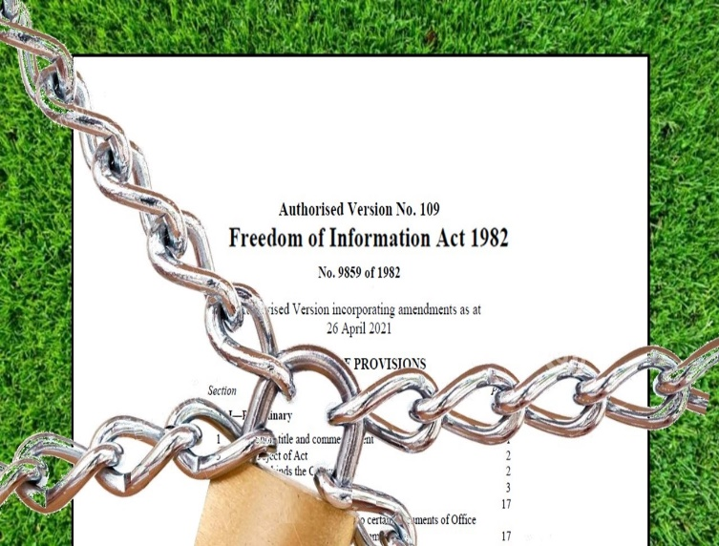
Introduction to FOI
Why do you need to know about FOI?

Slide 14
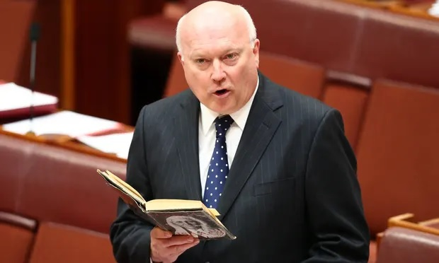


Introduction to FOI (1)
Attorney General v Dreyfus
The “Streisand Effect”
Is that “George Brandis’ diary”?

Slide 15
Introduction to FOI (2)
VGSO WoVG Legal Induction Program | Information sharing in government
Freedom of information is a key
component of executive accountability
and a pillar of our democracy.
Governed by the Freedom of Information Act 1982
Notes:
\

Slide 16
Object
VGSO WoVG Legal Induction Program | Information sharing in government
Object of the FOI Act – s 3 of FOI Act
  ‘…creating a general right of access to information in documentary form in the possession of Ministers and agencies…’

Slide 17
Access
VGSO WoVG Legal Induction Program | Information sharing in government
Broad right of access – s 13 of FOI Act
  Every person has a legally enforceable right to obtain access to a document of an agency, or…a Minister, other than an exempt document.
  Can also release documents outside of the FOI Act – s 16

Slide 18
Key Definitions (s 5)
VGSO WoVG Legal Induction Program | Information sharing in government
Which documents?
Document’ – very broad and includes maps, photos, film and audio
'Document of an agency‘ – document in possession of agency (also encompasses control)
‘Official document of a Minister’ – in possession of a Minister that relates to the affairs of an agency.

Slide 19
Processing a FOI request
VGSO WoVG Legal Induction Program | Information sharing in government
Consider:
Is the request valid according to s 17?
30 day limit to make a decision – s 21
Requirements to conduct a thorough and diligent search
  What does this mean?

Slide 20
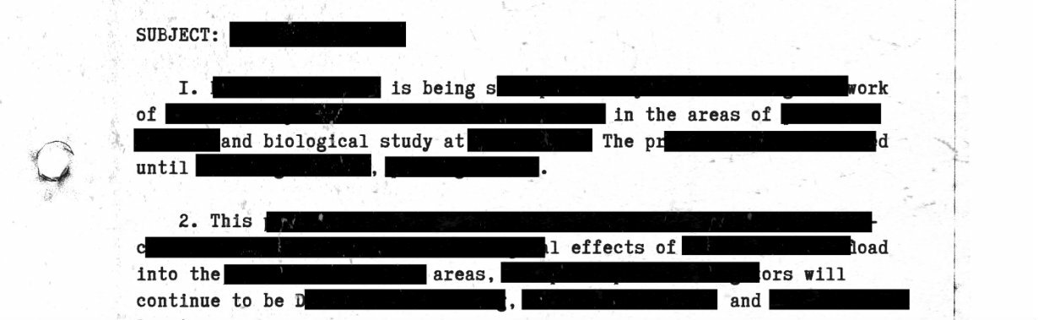
Processing an FOI request cont.
VGSO WoVG Legal Induction Program | Information sharing in government
Does an exemption apply?
(See ss 13 & 27)
Exemptions are provided for in Part IV of the Act
Irrelevant and exempt material can be deleted from a document– s 25……….

Slide 21
Exemptions in Part IV
VGSO WoVG Legal Induction Program | Information sharing in government
Section 28 - Cabinet documents
Official records of Cabinet deliberation or decisions or documents prepared for Cabinet
Include committees and sub-committees of Cabinet
Does not apply to documents more than 10 years old
Notes:
I’m going to go through some key exemptions under Part IV, noting that there are a lot of exemptions applicable. These are the 5 most common ones to expect

Slide 22
Exemptions in Part IV cont.
VGSO WoVG Legal Induction Program | Information sharing in government
Section 30 – Internal working documents
Documents containing an opinion, advice or recommendation prepared by an officer or Minister
Would be contrary in the public interest to release

Slide 23

Exemptions in Part IV cont.
VGSO WoVG Legal Induction Program | Information sharing in government
Section 33 - Personal privacy
Information relating to the personal affairs of any person and it would be unreasonable to disclose this information
‘Personal affairs’ includes information that discloses a person’s identity, address or location
Need to consult persons affected

Slide 24
Exemptions in Part IV cont.
VGSO WoVG Legal Induction Program | Information sharing in government
Section 35(1)(b) – Confidential communication
Where release would divulge information communicated in confidence to an agency or Minister
Release would impair the ability to obtain similar information in the future

Slide 25
Exemptions in Part IV cont.
VGSO WoVG Legal Induction Program | Information sharing in government
Section 38 – Secrecy provisions of enactments
Three criteria must be satisfied:
  there is an enactment in force;
  applies specifically to the requested information; and
  prohibits disclosure of that information.

Slide 26
Would this document be released under FOI?
VGSO WoVG Legal Induction Program | Information sharing in government
A VGSO invoice for legal services

Slide 27
What might be exempt?
VGSO WoVG Legal Induction Program | Information sharing in government
Releasable, but with some parts omitted

Slide 28
Conclusion
VGSO WoVG Legal Induction Program | Information sharing in government
The starting point in FOI should always be release the requested information unless an exemption applies.
VGSO is able to provide support to agencies for all FOI related matters.

Slide 29
Questions
VGSO WoVG Legal Induction Program | Information sharing in government
Rebecca Radford
Lead Counsel
Commercial, Property & Technology
Victorian Government Solicitor’s Office
e. rebecca.radford@vgso.vic.gov.au
Andrew Field
Managing Principal Solicitor
Inquiries, Prosecutions and Administrative Law
Victorian Government Solicitor’s Office
e. andrew.field@vgso.vic.gov.au

