Slide 1
Principles of public finance law in Victoria
Nidal Sayegh, Lead Counsel
10 June 2025

Slide 2
Matters covered
VGSO WoVG Legal Induction Program | Financial management
2
Getting money in
Holding and managing public funds
Permission to spend
Releasing money
Responding to changing circumstances
Reporting and accountability

Slide 3
Getting money in
VGSO WoVG Legal Induction Program | Financial management
3
Taxes
Fees and fines
Sales of capital assets
Sales of goods and services
Dividends and interest
Grants from the Commonwealth.

Slide 4
Getting money in
VGSO WoVG Legal Induction Program | Financial management
4
General Government Sector (2025-26 budget estimate) | %
Taxation | 38
Dividends, income tax equivalent revenue, interest | 2
Sales of goods and services | 7
Commonwealth grants | 49
Other | 3

Slide 5
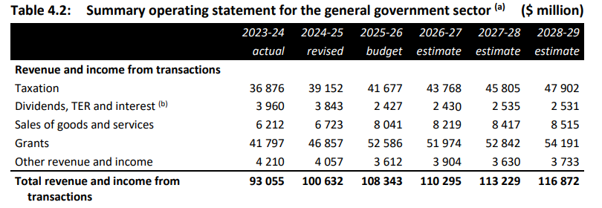
Getting money in
VGSO WoVG Legal Induction Program | Financial management
5
General Government Sector

Slide 6
Getting money in
VGSO WoVG Legal Induction Program | Financial management
6
A Bill for imposing any duty, rate, tax, rent, return or impost must originate in the Assembly (Constitution Act 1975, s 62(1))
However, a Bill is not such a Bill if all it does is impose fines or other pecuniary penalties, or has provisions for licence fees or fees for services: Constitution Act 1975, s 64(1).
Such a Bill may be rejected by the Legislative Council, but not amended by it (Constitution Act 1975, s 62(2)).

Slide 7
Matters covered
VGSO WoVG Legal Induction Program | Financial management
7
Getting money in
Holding and managing public funds
Permission to spend
Releasing money
Responding to changing circumstances
Reporting and accountability

Slide 8
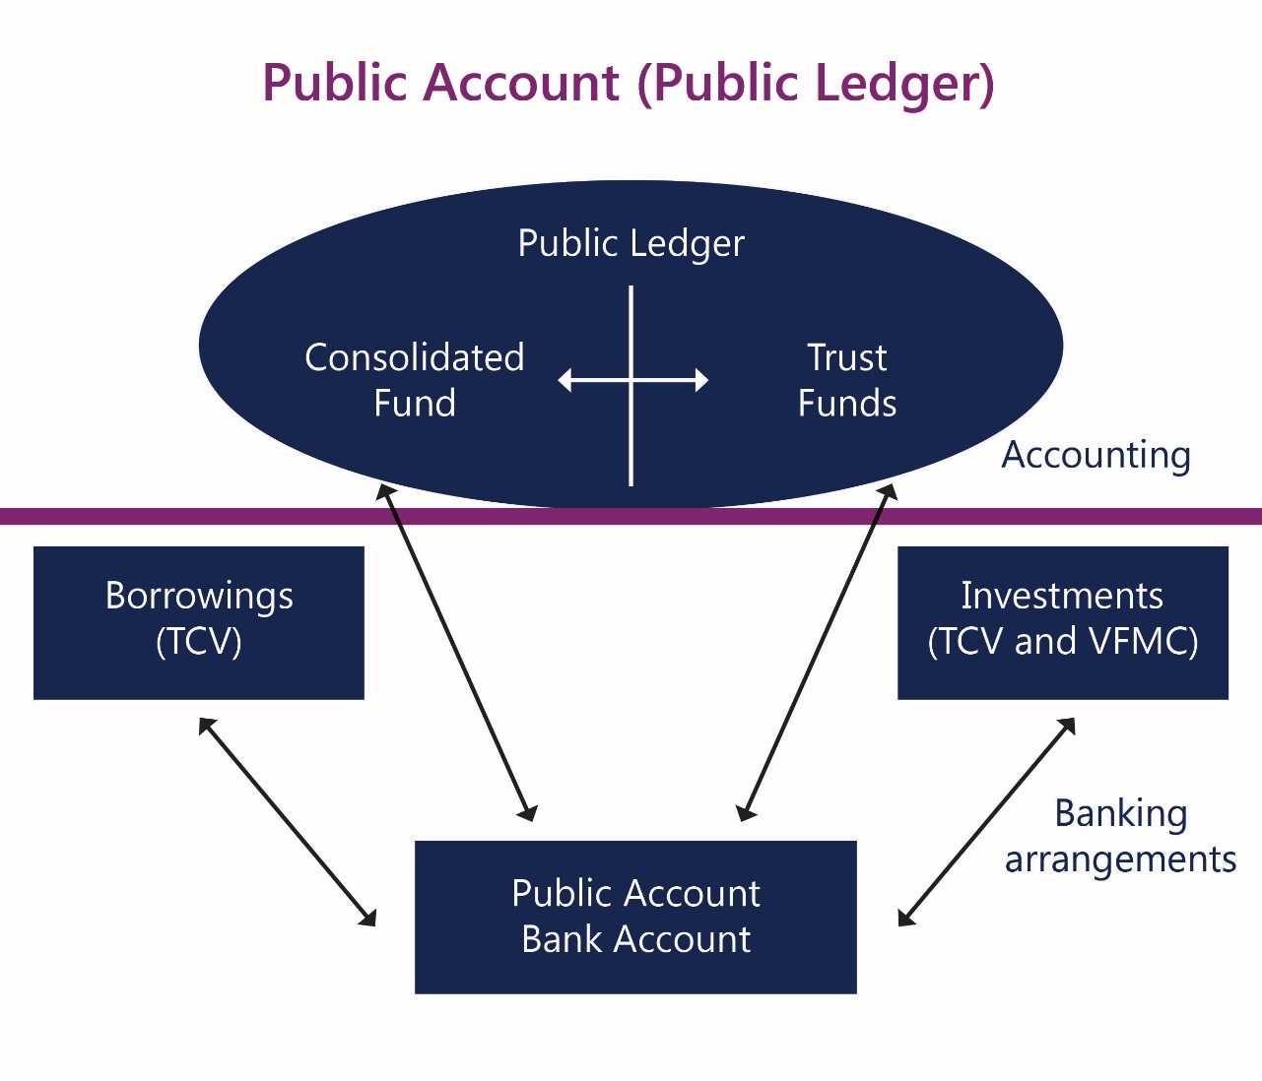
Holding and managing funds
VGSO WoVG Legal Induction Program | Financial management
8

Slide 9
Holding and managing funds
VGSO WoVG Legal Induction Program | Financial management
9
All taxes imposts rates and duties (etc) shall form one Consolidated Revenue (Constitution Act 1975 s 89)
A person who collects or receives public money must pay the money into the Public Account. (FMA s 16)
The Minister must open and maintain the Public Account with such authorised deposit-taking institution(s) as the Minister determines (FMA s 14)
The Minister must ensure that a ledger is established and maintained to record (a) transactions on the Public Account; and (b) expenses and obligations incurred that are to be met out of the Public Account (FMA s 13)

Slide 10
Holding and managing funds
VGSO WoVG Legal Induction Program | Financial management
10
Note: departments and agencies cannot borrow or invest money unless they are explicitly permitted to do so, in that particular way, by the Borrowing and Investment Powers Act 1987.

Slide 11
Matters covered
VGSO WoVG Legal Induction Program | Financial management
11
Getting money in
Holding and managing public funds
Permission to spend
Releasing money
Responding to changing circumstances
Reporting and accountability

Slide 12
Permission to spend
VGSO WoVG Legal Induction Program | Financial management
12
The Consolidated Revenue …shall be subject to be appropriated to such specific purposes as by any Act shall be provided in that behalf. (Constitution Act 1975, s 92)
A Bill for appropriating any part of the Consolidated Fund must originate in the Assembly. (Constitution Act 1975 s 62(1))
The Assembly may not pass any vote resolution or Bill for appropriating any part of the Consolidated Fund…which has not been first recommended by a message of the Governor to the Assembly during the session in which such vote resolution or Bill is passed. (Constitution Act 1975, s 63)

Slide 13
Permission to spend
VGSO WoVG Legal Induction Program | Financial management
13
Annual Appropriation Bill
A Bill which deals only with the annual appropriation of the Consolidated Fund for the ordinary annual services of the Government for a particular year only but does not include a Bill to appropriate money for appropriations for or relating to the Parliament. (Constitution Act s 65(1))
Note there is a distinction between annual and special appropriations.

Slide 14
Permission to spend
VGSO WoVG Legal Induction Program | Financial management
14
Annual Appropriation Bill – special rules
An Annual Appropriation Bill requires only passage in the Legislative Assembly and Royal Assent—in other words, it cannot be rejected by the Legislative Council, although the Legislative Council does have one month to consider it and make suggestions to the Assembly.
(Constitution Act s 65)

Slide 15
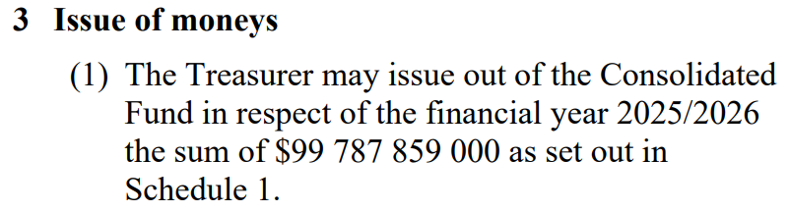
Permission to spend
VGSO WoVG Legal Induction Program | Financial management
15

Slide 16
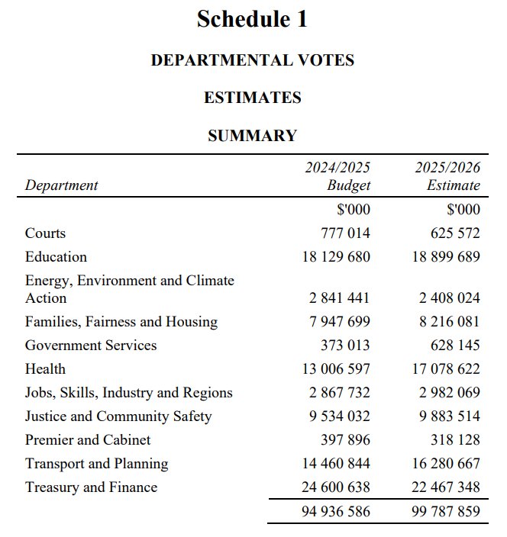
Permission to spend
VGSO WoVG Legal Induction Program | Financial management
16

Slide 17
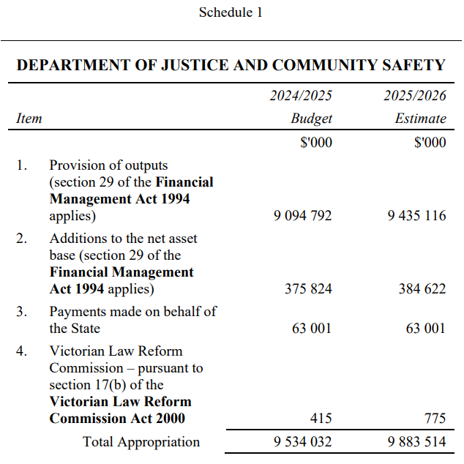
Permission to spend
VGSO WoVG Legal Induction Program | Financial management
17

Slide 18
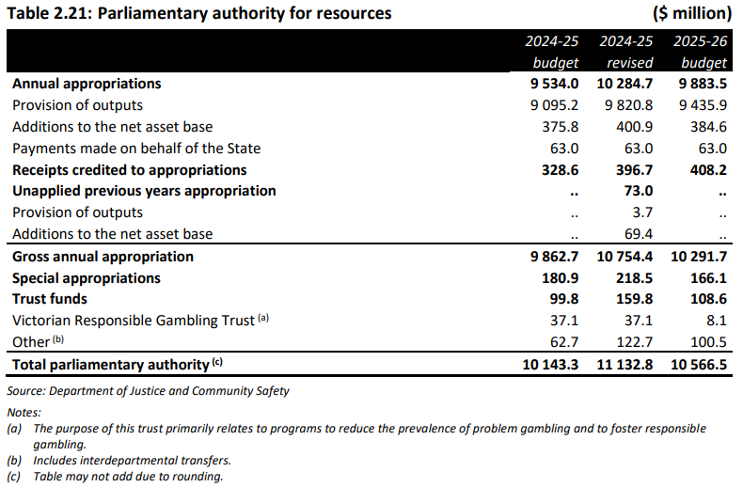
Permission to spend
VGSO WoVG Legal Induction Program | Financial management
18

Slide 19
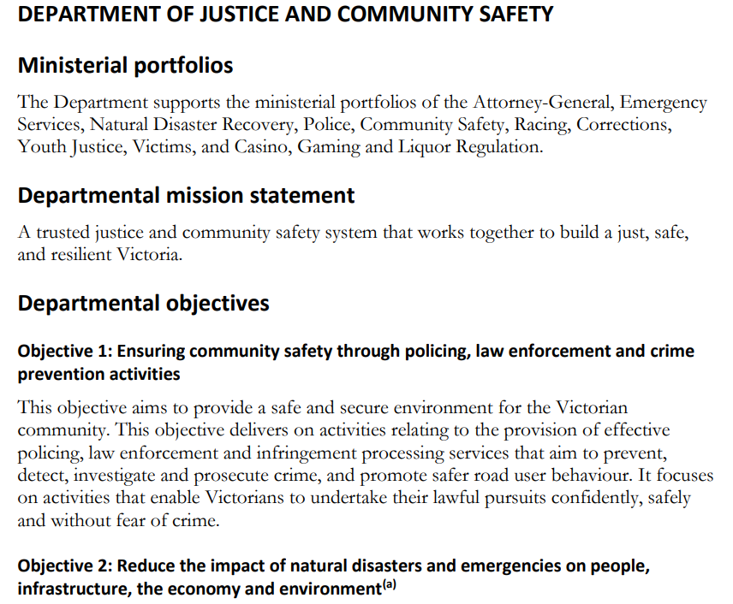
Permission to spend
VGSO WoVG Legal Induction Program | Financial management
19

Slide 20
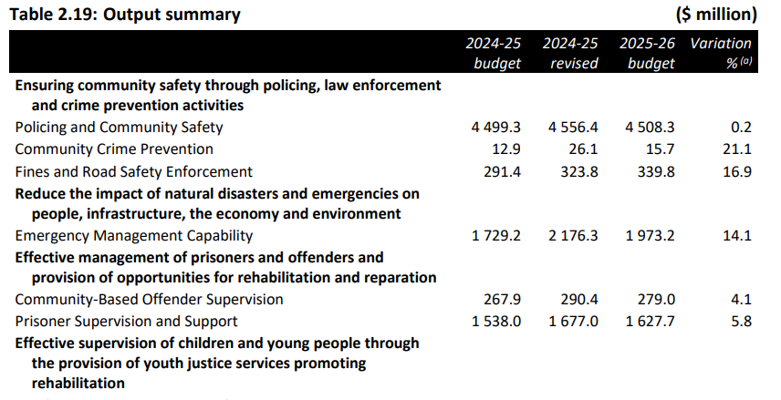
Permission to spend
VGSO WoVG Legal Induction Program | Financial management
20

Slide 21
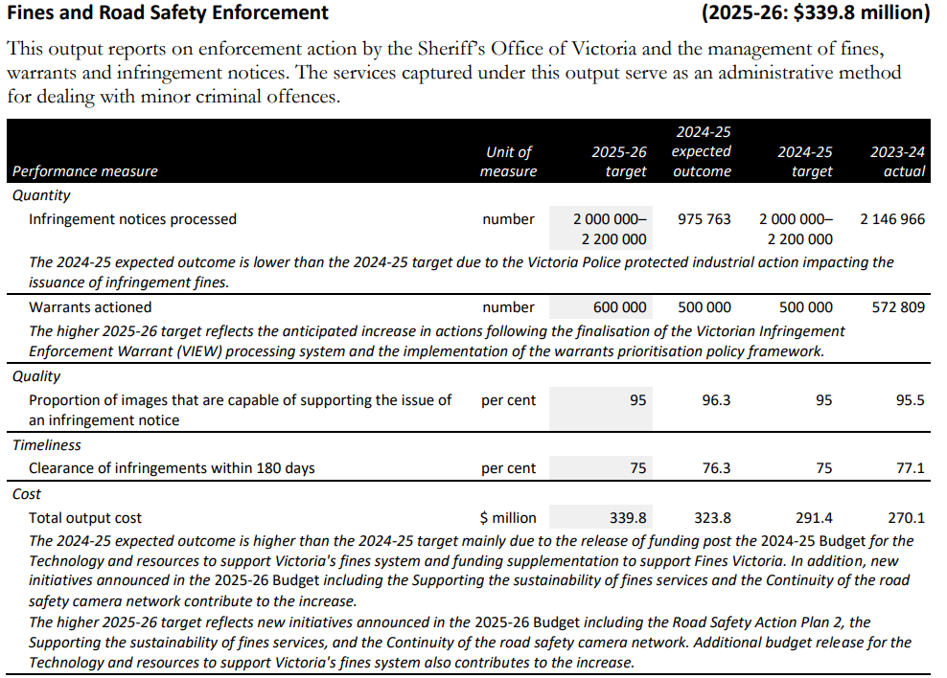
Permission to spend
VGSO WoVG Legal Induction Program | Financial management
21

Slide 22
Permission to spend
VGSO WoVG Legal Induction Program | Financial management
22
Special appropriations:
where it is important for the institutions of the State that there be no doubt that money will be available to support the institution (eg, the salaries of the Governor and judges);
where it cannot be known if and when money will have to be paid, but when those circumstances arise there must be no doubt that it is available; and
where it is a necessary and incontestable part of Government that funds be available to fulfil its purpose (e.g. elections).

Slide 23
Matters covered
VGSO WoVG Legal Induction Program | Financial management
23
Getting money in
Holding and managing public funds
Permission to spend
Releasing money
Responding to changing circumstances
Reporting and accountability

Slide 24
Releasing money
VGSO WoVG Legal Induction Program | Financial management
24
Release to the Government
  Warrants
Release by the Government to departments
  State Administration Unit

Slide 25
Releasing money
VGSO WoVG Legal Induction Program | Financial management
25
Spending by departments
FMA: specific provisions regarding things like asset registers and risk management strategies (s 44B), writing off (s 55), recovery of overpayments (s 56) and how departments manage and use funds.

Slide 26
Releasing money
VGSO WoVG Legal Induction Program | Financial management
26
Spending by departments
Directions made by the Assistant Treasurer under s 8 FMA
FMA Standing Directions (Binding)
FMA Standing Directions Instructions (Binding)
FMA Standing Directions Guidance (Non-binding)

Slide 27
Releasing money
VGSO WoVG Legal Induction Program | Financial management
27
Directions cover requirements relating to:
  financial management governance;
  internal controls and audit;
  Audit Committees;
  financial reporting;
  financial compliance; and
  financial authorisations and discretionary financial benefits

Slide 28
Releasing money
VGSO WoVG Legal Induction Program | Financial management
28
Purchasing by government Departments (but not by statutory authorities) is regulated by supply policies, which are made by the Victorian Government Purchasing Board under s 54L(1) of the FMA

Slide 29
Matters covered
VGSO WoVG Legal Induction Program | Financial management
29
Getting money in
Holding and managing public funds
Permission to spend
Releasing money
Responding to changing circumstances
Reporting and accountability

Slide 30
Responding to changing circumstances
VGSO WoVG Legal Induction Program | Financial management
30
Moving funds between financial years:
Borrowing against future appropriation (s 28 FMA)
Carryover of unused appropriation (s 32 FMA)
Access to Department account balances (s 33 FMA)

Slide 31
Responding to changing circumstances
VGSO WoVG Legal Induction Program | Financial management
31
Obtaining additional funds:
Treasurer’s Advance (Appropriation Act)
Additional payments for salaries (Appropriation Act)
Temporary Advance (s 35 FMA)
Public Account advance (s 37 FMA)

Slide 32
Matters covered
VGSO WoVG Legal Induction Program | Financial management
32
Getting money in
Holding and managing public funds
Permission to spend
Releasing money
Responding to changing circumstances
Reporting and accountability

Slide 33
Reporting and accountability
VGSO WoVG Legal Induction Program | Financial management
33
Quarterly reporting
Annual audited accounts (Auditor General)
Public Accounts and Estimates Committee:
  Report on budget estimates (annual budget)
  Report on Financial and Performance Outcomes (annual financial statements of departments).

Slide 34
Conclusion
VGSO WoVG Legal Induction Program | Financial management
34
Important and ongoing dynamic between the government and the Parliament
Many matters have complex and very specific rules
Extensive process of reporting and accountability, with PAEC playing a particular role in considering the budgets and annual reports of departments.

Slide 35
Quiz
What is Victoria’s biggest source of revenue in its budget?
  Commonwealth grants
If a person collects or receives public money, where must they put it?
  The Consolidated Fund

Slide 36
Quiz
What are the two forms of appropriation?
  Annual and special
What is one way of obtaining additional funds outside of an annual appropriation?
  Treasurer’s advance; temporary advance, Public Account advance; borrowing against future appropriation; carryovers

Slide 37
Questions?
VGSO WoVG Legal Induction Program | Financial management
35
Nidal Sayegh
Lead Counsel
e. nidal.sayegh@vgso.vic.gov.au

